Slide 1
Chapter 5: Joint Probability and Random Samples
5.1 Jointly distributed random variables
5.2 Expected values, covariance, and correlation
5.3 Statistics and their distributions
5.4 The distribution of the sample mean
5.5 The distribution of a linear combination

Slide 2
5.1 Jointly Distributed Random Variables

Slide 3
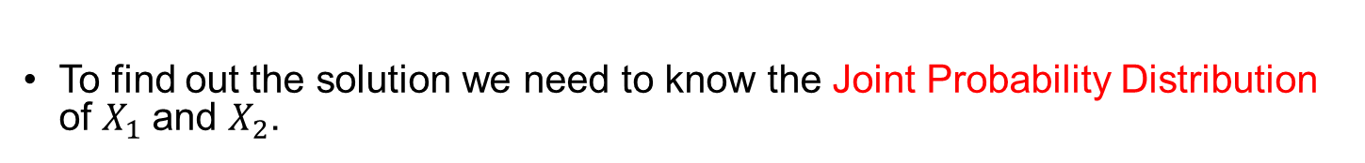
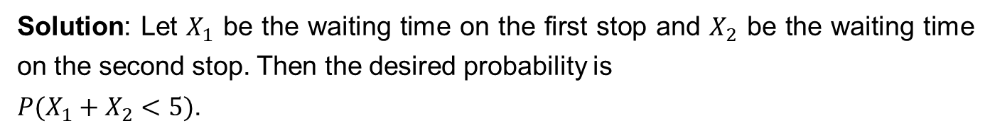
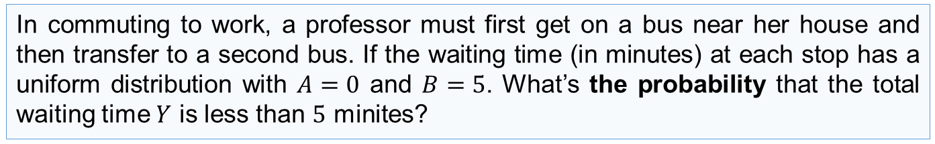
Introduction
In Chapters 3 and 4, we developed probability models for a single random variable. However many problems in probability and statistics involve several random variables simultaneously.
Example
In commuting to work, a professor must first get on a bus near her house and then transfer to a second bus. If the waiting time (in minutes) at each stop has a uniform distribution with $A=0$ and $B=5$. What’s the probability that the total waiting time $Y$ is less than $5$ minites?
Solution: Let $X_{1}$ be the waiting time on the first stop and $X_{2}$ be the waiting time on the second stop. Then the desired probability is
$P(X_{1}+X_{2}<5)$.
To find out the solution we need to know the Joint Probability Distribution of $X_{1}$and $X_{2}$.

Slide 4
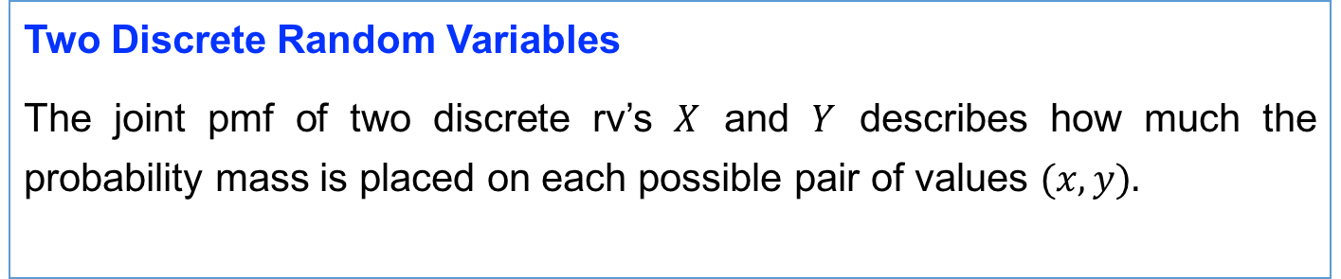
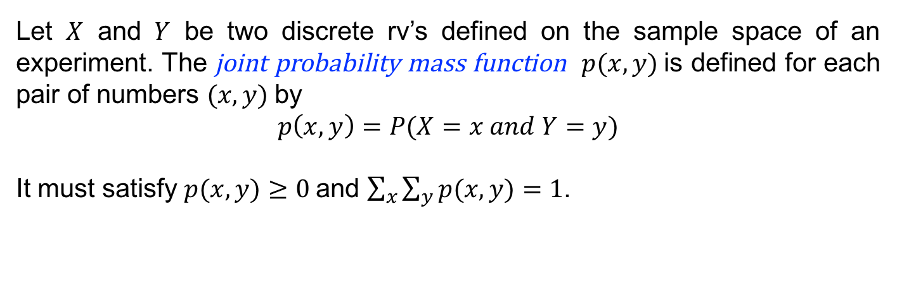
Two Discrete Random Variables
The joint pmf of two discrete rv’s $X$ and $Y$ describes how much the probability mass is placed on each possible pair of values $(x, y).$
Let $X$ and $Y$ be two discrete rv’s defined on the sample space of an experiment. The joint probability mass function $p(x, y)$is defined for each pair of numbers $(x, y)$by
$$p\left(x,y\right)=P(X=x and Y=y)$$
It must satisfy $p(x, y)≥0$and $\sum_{x}{\sum_{y}{p(x,y)}}=1$.

Slide 5










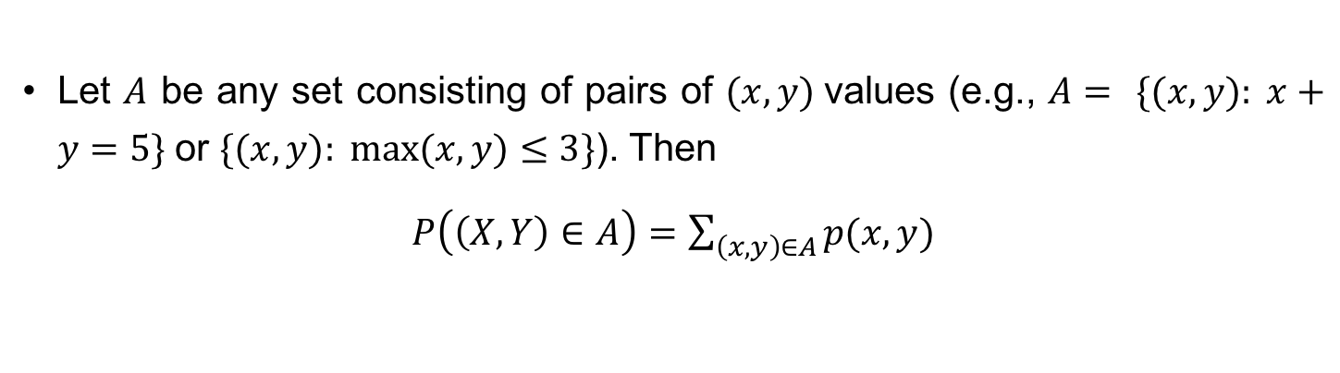

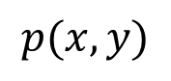
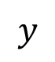




Let $A$ be any set consisting of pairs of $(x, y)$values (e.g., $A=$ $\{(x, y): x+y=5\}$or $\{(x, y): max⁡(x, y)≤3\}$). Then
$P\left(\left(X,Y\right)∈A\right)=\sum_{\left(x,y\right)∈A}{p(x,y)}$
Example
Let $X$ and $Y$ be the number of statistics and mathematics courses, respectively, currently being taken by a randomly selected statistics major.
Suppose the joint pmf is given in the following joint probability table:
$$y$$
$$p(x,y)$$
$$0$$
$$1$$
$$2$$
$$x$$
$$1$$
$$0.1$$
$$0.2$$
$$0.2$$
$$2$$
$$0.05$$
$$0.15$$
$$0.3$$
$$P\left(X=1 and Y=1\right)=p\left(1,1\right)=0.2$$
$P\left(Y≥1\right)$= $p\left(1,1\right)+p\left(2,1\right)+p\left(1,2\right)+p\left(2,2\right)=0.85$

Slide 6

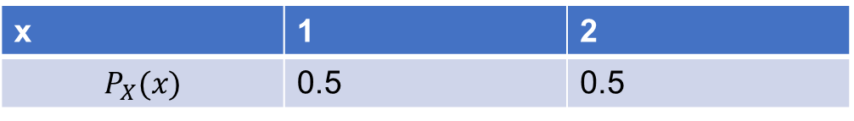
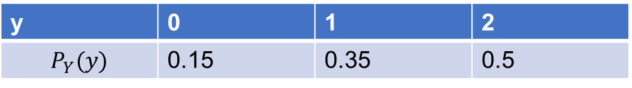





Question: What is the distribution of $Y$?
The possible values of $Y$ are $0, 1$ and $2$. The pmf of $Y$ is
$$p_{Y}\left(0\right)=P\left(Y=0\right)=p\left(0,0\right)+p\left(1,0\right)=0.15$$
$$p_{Y}\left(1\right)=P\left(Y=1\right)=p\left(0,1\right)+p\left(1,1\right)=0.35$$
$$p_{Y}\left(2\right)=P\left(Y=2\right)=p\left(0,2\right)+p\left(1,2\right)=0.5$$
y | 0 | 1 | 2
$$P_{Y}(y)$$ | 0.15 | 0.35 | 0.5
The possible values of $X$ are $1$ and $2$. The pmf of $X$ is
x | 1 | 2
$$P_{X}(x)$$ | 0.5 | 0.5

Slide 7
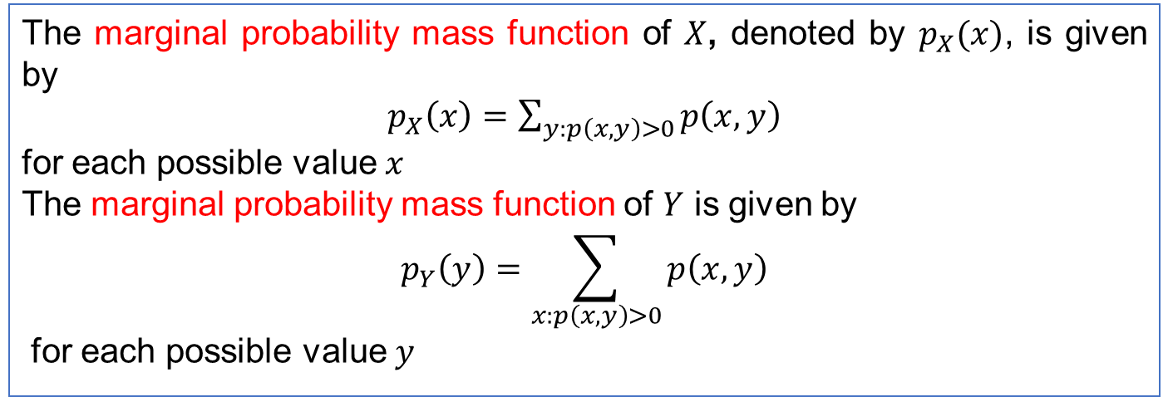
Definition (marginal probability mass function)
The marginal probability mass function of $X$, denoted by $p_{X}(x)$, is given by
$p_{X}\left(x\right)=\sum_{y:p\left(x,y\right)>0}{p\left(x,y\right)}$
for each possible value $x$
The marginal probability mass function of $Y$ is given by
$$p_{Y}\left(y\right)=\sum_{x:p\left(x,y\right)>0}{p\left(x,y\right)}$$
for each possible value $y$

Slide 8














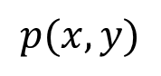
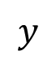




The use of the word marginal here is a consequence of the fact that if the joint pmf is displayed in a rectangular table as
then the row totals give the marginal pmf of $X$ and the column totals give the marginal pmf of $Y$.
$$y$$
$$p(x,y)$$
$$0$$
$$1$$
$$2$$
$$x$$
$$1$$
$$0.1$$
$$0.2$$
$$0.2$$
$$0.5$$
$$2$$
$$0.05$$
$$0.15$$
$$0.3$$
$$0.5$$
$$0.15$$
$$0.35$$
$$0.5$$

Slide 9
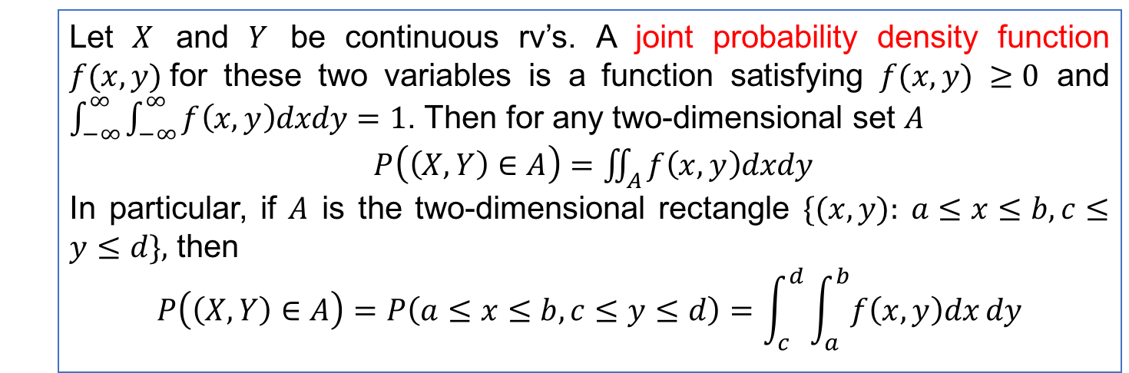
Definition (Joint probability density function )
Let $X$ and $Y$ be continuous rv’s. A joint probability density function $f(x, y)$for these two variables is a function satisfying $f(x, y) ≥0$ and $\int_{−∞}^{∞}{\int_{−∞}^{∞}{f\left(x,y\right)dxdy}}=1$. Then for any two-dimensional set $A$
$P\left(\left(X,Y\right)∈A\right)=\iint_{A}^{ }{f\left(x,y\right)dxdy}$
In particular, if $A$ is the two-dimensional rectangle $\{(x, y): a≤x≤b, c≤y≤d\},$ then
$$P\left(\left(X,Y\right)∈A\right)=P\left(a≤x≤b,c≤y≤d\right)=\int_{c}^{d}{\int_{a}^{b}{f\left(x,y\right)dx}dy}$$

Slide 10

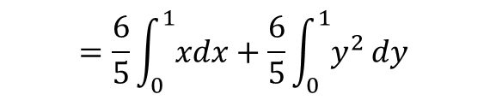



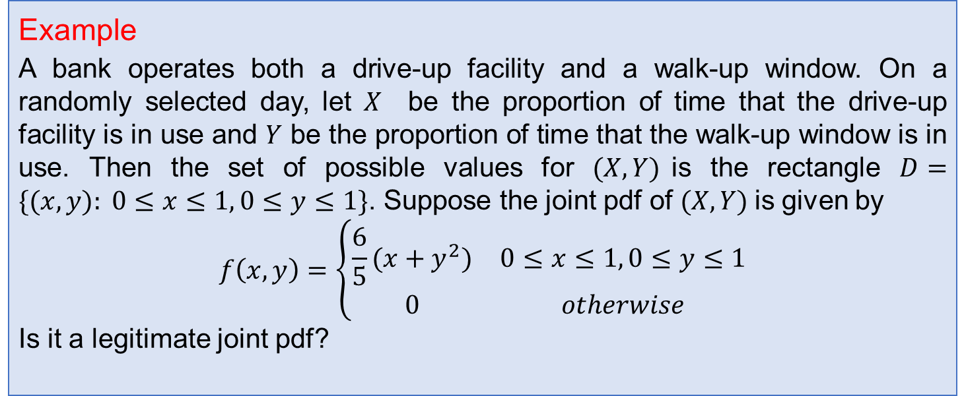
Example
A bank operates both a drive-up facility and a walk-up window. On a randomly selected day, let $X$ be the proportion of time that the drive-up facility is in use and $Y$ be the proportion of time that the walk-up window is in use. Then the set of possible values for $(X, Y)$is the rectangle $D=\{(x, y): 0≤x≤1, 0≤y≤1\}$. Suppose the joint pdf of $(X, Y)$is given by
$$f\left(x,y\right)=\left\{\begin{matrix}\frac{6}{5}(x+y^{2}) & 0≤x≤1, 0≤y≤1 \\ 0 & otherwise\end{matrix}\right.$$
Is it a legitimate joint pdf?
Solution Note that $f(x,y)≥0$, and
$$\int_{0}^{1}{\int_{0}^{1}{\frac{6}{5}\left(x+y^{2}\right)dxdy}}=$$
$$\frac{6}{5}\int_{0}^{1}{\int_{0}^{1}{xdxdy }+\frac{6}{5}\int_{0}^{1}{\int_{0}^{1}{y^{2}}dxdy}}$$
$$=\frac{6}{5}\int_{0}^{1}{xdx}+\frac{6}{5}\int_{0}^{1}{y^{2}}dy$$
$=\frac{3}{5}+\frac{2}{5}=1$
The join pdf is legitimate.

Slide 11
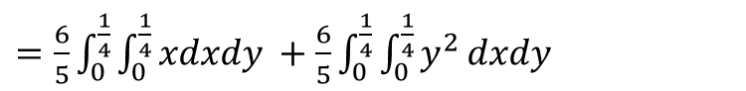
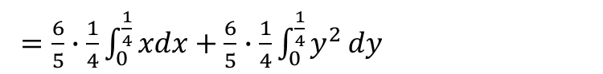


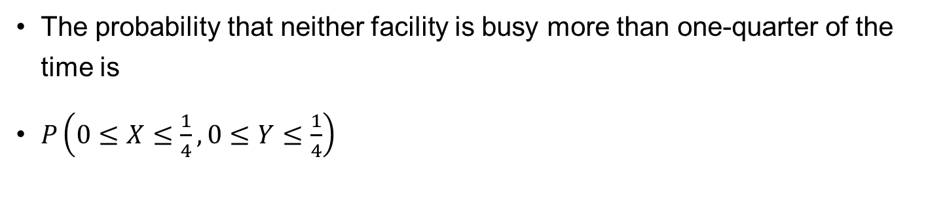
The probability that neither facility is busy more than one-quarter of the time is
$P\left(0≤X≤\frac{1}{4}, 0≤Y≤\frac{1}{4}\right)$
$=\frac{6}{5}\int_{0}^{\frac{1}{4}}{\int_{0}^{\frac{1}{4}}{xdxdy }+\frac{6}{5}\int_{0}^{\frac{1}{4}}{\int_{0}^{\frac{1}{4}}{y^{2}}dxdy}}$
$=\frac{6}{5}∙\frac{1}{4}\int_{0}^{\frac{1}{4}}{xdx}+\frac{6}{5}∙\frac{1}{4}\int_{0}^{\frac{1}{4}}{y^{2}}dy$
$=\frac{3}{10}∙\frac{1}{2}∙\frac{1}{16}+\frac{3}{10}∙\frac{1}{3}∙\frac{1}{64}$
$=\frac{7}{640}$

Slide 12


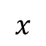



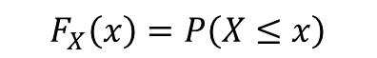
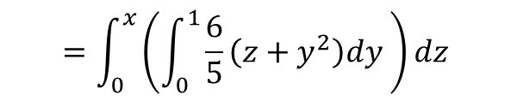
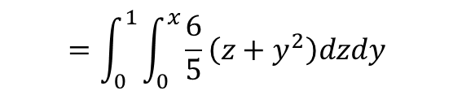
Question
What is the distribution of $X$?
Solution $X$ is a continuous rv. Let the cdf of $X$ be $F_{X}(x)$.
For any $0≤x≤1$,
$$F_{X}\left(x\right)=P\left(X≤x\right)$$
$$=P\left(0≤X≤x, 0≤Y≤1\right)$$
$$=\int_{0}^{1}{\int_{0}^{x}{\frac{6}{5}\left(z+y^{2}\right)dzdy}}$$
$$=\int_{0}^{x}{\left(\int_{0}^{1}{\frac{6}{5}\left(z+y^{2}\right)dy }\right)dz}$$
$$1$$
$$x$$
$$1$$

Slide 13
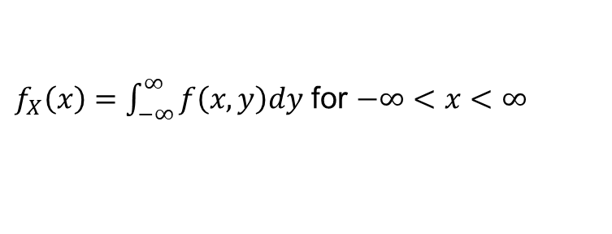
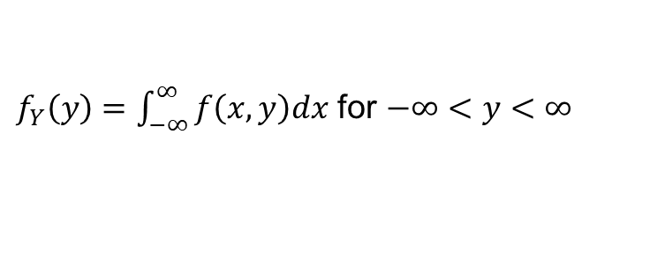

The marginal probability density functions of $X$ and $Y$, denoted by $f_{X}(x)$and $f_{Y}(y)$, respectively, are given by
$f_{X}\left(x\right)=\int_{−∞}^{∞}{f\left(x,y\right)dy}$ for $−∞<x<∞$
$f_{Y}\left(y\right)=\int_{−∞}^{∞}{f\left(x,y\right)dx}$ for $−∞<y<∞$

Slide 14










Example (Continued)
The marginal pdf of $X$, which gives the probability distribution of busy time for the drive-up facility without reference to the walk-up window, is
for $0≤x≤1$,
$$f_{X}\left(x\right)=\int_{−∞}^{∞}{f\left(x,y\right)dy}$$
$$=\int_{0}^{1}{\frac{6}{5}\left(x+y^{2}\right)dy }$$
$=\frac{6}{5}x+\frac{2}{5}$,
otherwise, $f_{X}\left(x\right)=0$.
The marginal pdf of $Y$ is
for $0≤y≤1$,
$$f_{Y}\left(y\right)=\int_{−∞}^{∞}{f\left(x,y\right)dx}=\int_{0}^{1}{\frac{6}{5}\left(x+y^{2}\right)dx=\frac{3}{5}+\frac{6}{5}y^{2}\text{,} }$$
otherwise, $f_{Y}\left(y\right)=0$.
Then $P\left(\frac{1}{4}≤Y≤\frac{3}{4}\right)$
$=\int_{1/4}^{3/4}{f_{Y}}\left(y\right)dy$ $=\frac{3}{5}∙\frac{1}{2}+\frac{2}{5}y^{3}\left|{y=3/4 \atop y=1/4}\right.$ $=\frac{37}{80}$

Slide 15







Example
Suppose the joint pdf of $(X, Y)$is given by
$$f\left(x,y\right)=\left\{\begin{matrix}24xy & 0≤x≤1, 0≤y≤1, x+y≤1 \\ 0 & otherwise\end{matrix}\right.$$
Is it a legitimate joint pdf?
Note that $f(x,y)≥0$, and
$$\int_{−∞}^{∞}{\int_{−∞}^{∞}{f(x,y)}dx}dy=\iint_{D}^{ }{f\left(x,y\right)dxdy}$$
$=\int_{0}^{1}{\left(\int_{0}^{1−x}{24xy}dy\right)dx}$
$=\int_{0}^{1}{12x{\left(1−x\right)}^{2}dx}=1$
Yes.
$$1$$
$$D$$
$$1$$

Slide 16














Let $A=\{\left(x,y\right), 0≤x≤1, 0≤y≤1,and x+y≤0.5\}$. Then
$$P\left(\left(X,Y\right)∈A\right)=\iint_{A}^{ }{f\left(x,y\right)dxdy}$$
$=\int_{0}^{0.5}{\left(\int_{0}^{0.5−x}{24xydy}\right)}dx$
$$1$$
$$A$$
$=\int_{0}^{0.5}{12x{\left(0.5−x\right)}^{2}dx}$
$=\frac{1}{16}$
$$1$$
For any $0≤x≤1$,
$f_{X}\left(x\right)=\int_{0}^{1−x}{24xydy}=12x{\left(1−x\right)}^{2}$.
Otherwise, $f_{X}\left(x\right)=0$.
For any $0≤y≤1$,
$f_{Y}\left(y\right)=\int_{0}^{1−y}{24xydx}=12y{\left(1−y\right)}^{2}$.
Otherwise, $f_{Y}\left(y\right)=0$.

Slide 17



Independent Random Variables
In Chapter 2, we define two events $A$ and $B$ to be independent if $P\left(A | B\right)=P\left(A\right)$.
And then we found that two events $A$ and $B$ are independent if and only if $P\left(A∩B\right)=P(A)∙P(B)$.
Intuitively, independence of two events$A$ and $B$ says that whether $A$ will occur or not is not affected by the knowledge that $B$ has occurred.
Now we define the independence of two rv’s.
Intuitively, independence of two rv’s says that what the value of one rv might be is not affected by the value of the other rv.

Slide 18

Definition (Independence)
Two random variables $X$ and $Y$are said to be independent if for every pair of $x$ and $y$ values
$p\left(x,y\right)=p_{X}(x)∙p_{Y}\left(y\right)$ when $X$ and $Y$ are discrete
or
$f\left(x,y\right)=f_{X}(x)∙f_{Y}\left(y\right)$ when $X$ and $Y$ are continuous
If the above condition is not satisfied for all $(x, y),$then $X$ and $Y$ are said to be dependent.

Slide 19








Example
Suppose the joint probability table of two discrete rv’s $X$ and $Y$ is given by
Are $X$ and $Y$ independent?
$$y$$
$$p(x,y)$$
$$0$$
$$1$$
$$2$$
$$x$$
$$1$$
$$0.1$$
$$0.2$$
$$0.2$$
$$0.5$$
$$0.3$$
$$2$$
$$0.5$$
$$0.05$$
$$0.15$$
$$0.15$$
$$0.35$$
$$0.5$$
Solution:
$p\left(1,0\right)=0.1$
$$p_{X}\left(1\right)∙p_{Y}\left(0\right)=0.5×0.15=0.075$$
$$p(1,0)≠p_{X}\left(1\right)∙p_{Y}\left(0\right)$$
Independence of $X$ and $Y$requires that every entry in the joint probability table be the product of the corresponding row and column marginal probabilities.
And thus $X$ and $Y$ are not independent.

Slide 20



Example
Suppose the joint pdf of $(X, Y)$is given by
$$f\left(x,y\right)=\left\{\begin{matrix}24xy & 0≤x≤1, 0≤y≤1, x+y≤1 \\ 0 & otherwise\end{matrix}\right.$$
Are $X$ and $Y$ independent?
Solution: $f_{X}(x)=12x{\left(1−x\right)}^{2}$, for any $0≤x≤1$.
$f_{Y}(y)=12y{\left(1−y\right)}^{2}$, for any $0≤y≤1$.
Obviously $f(x,y)≠f_{X}(x)∙f_{Y}(y)$, $0<x≤1$ and $0<y≤1$
And thus $X$ and $Y$ are not independent.

Slide 21



In application, if the experiment under study suggests that $X$and $Y$ have no effect on one another, then we can compute the joint pmf or pdf by the product of the marginal pmf’s or pdf’s.
Moreover, if two variables $X$ and $Y$ are independent, then
$$P\left(a≤X≤b,c≤Y≤d\right)=P(a≤X≤b)∙P(c≤Y≤d)$$

Slide 22







Example
Suppose that the lifetimes of two components are independent of one another and that the first lifetime, $X_{1}$, has an exponential distribution with parameter $λ_{1}$, whereas the second, $X_{2}$, has an exponential distribution with parameter $λ_{2}$. Then the joint pdf is
$$f\left(x_{1},x_{2}\right)$$
for $x_{1}>0, x_{2}>0$
$$=f_{X_{1}}\left(x_{1}\right)∙f_{X_{2}}\left(x_{2}\right)$$
$$=λ_{1}e^{−λ_{1}x_{1}}λ_{2}e^{−λ_{2}x_{2}}$$
$=λ_{1}λ_{2}e^{−(λ_{1}x_{1}+λ_{2}x_{2})}$,
$f\left(x_{1},x_{2}\right)=0$, otherwise.

Slide 23




Let $λ_{1}=1/1000$ and $λ_{2}=1/1200$ so that the expected lifetimes are $1000$ hours and $1200$hours, respectively. The probability that both component lifetimes are at least $1500$ hours is
$P\left(X_{1}≥1500, X_{2}≥1500\right)$
$$=P\left(X_{1}≥1500\right)P( X_{2}≥1500)$$
$$=\left[1−\left(1−e^{−{1500λ}_{1}}\right)\right]∙[1−\left(1−e^{−1500λ_{2}}\right)]$$
$${=e}^{−{1500λ}_{1}}e^{−1500λ_{2}}$$
$$=0.0639$$

Slide 24



Example
In commuting to work, a professor must first get on a bus near her house and then transfer to a second bus. If the waiting time (in minutes) at each stop has a uniform distribution with $A=0$ and $B=5$. What’s the pdf of the total waiting time $Y$.
Solution: Let $X_{1}$ be the waiting time on the first stop and $X_{2}$ be the waiting time on the second stop. The joint pdf is
$f\left(x_{1},x_{2}\right)=f_{X_{1}}(x_{1})∙f_{X_{2}}(x_{2})$ $=\frac{1}{25}$ if $0<x_{1}, x_{2}<5$
$f\left(x_{1},x_{2}\right)=0$, otherwise.
To find out the pdf of the total waiting time $Y$, we firstly find out its cdf
$F_{Y}\left(y\right)=P\left(Y≤y\right)=P\left(X_{1}+X_{2}≤y\right)$.

Slide 25














$$x_{2}$$
If $0<y≤5$,
$$y$$
$$F_{Y}\left(y\right)=\int_{0}^{y}{\int_{0}^{y−x_{2}}{\frac{1}{25}dx_{1}dx_{2}}}$$
$$=\frac{1}{25}∙\frac{y^{2}}{2}=\frac{1}{50}y^{2}$$
$$5$$
$$y$$
If $5<y≤10$,
$$5$$
$$x_{1}$$
$$F_{Y}\left(y\right)=1−\int_{y−5}^{5}{\int_{y−x_{2}}^{5}{\frac{1}{25}dx_{1}dx_{2}}}$$
$$=1−\frac{1}{25}∙\frac{({10−y)}^{2}}{2}=1−\frac{1}{50}{(10−y)}^{2}$$
$F_{Y}\left(y\right)=0$, if $y<0$and $F_{Y}\left(y\right)=1$, if $y>10$.
$f_{Y}\left(y\right)=F_{Y}^{′}(y)=\left\{\begin{matrix}\frac{1}{25}y & 0≤y<5 \\ \frac{2}{5}−\frac{1}{25}y & 5≤y≤10 \\ 0 & otherwise\end{matrix}\right.$

Slide 26





More Than Two Random Variables
More Than Two Random Variables
If $X_{1}, X_{2},…,X_{n}$ are all discrete random variables, the joint pmf of the variables is the function
$$p\left(x_{1},x_{2}, …,x_{n}\right)=P(X_{1}=x_{1},X_{2}=x_{2},…,X_{n}=x_{n})$$
If the variables are continuous, the joint pdf of $X_{1}, X_{2},…,X_{n}$is the function $f(x_{1}, x_{2},…,x_{n})$ such that for any $n$ intervals $\left[a_{1},b_{1}\right], …,\left[a_{n},b_{n}\right],$
$$P(a_{1}≤X_{1}≤b_{1},…,a_{n}≤X_{n}≤b_{n})$$
$=\int_{a_{1}}^{b_{1}}{⋯ }\int_{a_{n}}^{b_{n}}{f(x_{1}, x_{2},…,x_{n})}dx_{n}⋯dx_{1}$ .

Slide 27






Example (multinomial distribution)
Consider an experiment consisting of $n$ independent and identical
Trials, in which each trial can result in any one of $r$ possible outcomes.
Let $p_{i}=P$(outcome $i$ on any particular trial), and define random variables by $X_{i}$ the number of trials resulting in outcome $i$
$(i=1, . . . , r).$Such an experiment is called a multinomial experiment.
The joint pmf of $X_{1}, X_{2},…,X_{r}$is called the multinomial distribution.
$$p\left(x_{1},x_{2}, …,x_{r}\right)$$
$$=\frac{n!}{{(x}_{1}!)∙\left(x_{2}!\right)∙⋯∙\left(x_{r}!\right)}p_{1}^{x_{1}}⋯p_{r}^{x_{r}}$$
with $x_{1}+x_{2}+⋯+x_{r}=n$

Slide 28





Example
Let $X_{1}, X_{2},X_{3}$ be continuous rv’s. If their joint pdf is
$$f\left(x_{1}, x_{2}, x_{3}\right)=\left\{\begin{matrix}kx_{1}x_{2}(1−x_{3}) & 0≤x_{1},x_{2},x_{3}≤1, x_{1}+x_{2}+x_{3}≤1 \\ 0 & otherwise\end{matrix}\right.$$
What is the value of $k$?
$\int_{−∞}^{∞}{\int_{−∞}^{∞}{\int_{−∞}^{∞}{f\left(x_{1}, x_{2}, x_{3}\right)}dx_{1}dx_{2}dx_{3}}}$
$=\int_{0}^{1}{\left(\iint_{{0≤x}_{1},x_{2}≤1, x_{1}+x_{2}≤1−x_{3}}^{ }{{f(x}_{1},x_{2},x_{3})}dx_{1}dx_{2}\right)dx_{3}}$
$=\int_{0}^{1}{\left(\int_{0}^{1−x_{3}}{\left(\int_{0}^{1−x_{3}−x_{2}}{f\left(x_{1},x_{2},x_{3}\right) dx_{1}}\right)dx_{2}}\right)dx_{3}}$
$=\frac{k}{144}$
So $k=144$.

Slide 29



Definition (Conditional Probability)
Recall that for any two events $A$ and $B$ with $P(B)>0$, the conditional probability of $A$ given that $B$ has occurred is defined by
$P\left(A | B\right)=\frac{P(A∩B)}{P(B)}$.
Example
Suppose $X=$ the number of major defects in a randomly selected new automobile and $Y=$ the number of minor defects in that same auto. If we learn that the selected car has $m$ major defects, what now is the probability that the car has $n$ minor defects—that is, what is $P(Y=n|X=m)$?
$P\left(Y=n | X=m\right)=\frac{P(X=m, Y=n)}{P(X=m)}$ $=\frac{p\left(m,n\right)}{p_{X}(m)}$ ,
where $p(x, y)$ is the joint pmf of $X$ and $Y$, and $p_{X}(m)$ is the marginal pmf of $X$.

Slide 30



Definition (Conditional Pmf)
Let $X$ and $Y$ be two discrete rv’s with joint pmf $p(x, y)$ and marginal $X$ pmf $p_{X}(x)$. Then for any $X$ value $x$ for which $p_{X}\left(x\right)>0$, the conditional pmf of $Y$ given that $X=x$ is
$p_{Y|X}\left(y | x\right)=\frac{p(x,y)}{p_{X}(x)}$.
In the last example, if we learn that the selected car has one major defect, what now is the probability that the car has at most three minor defects?
$P\left(Y≤3 | X=1\right)=\sum_{n=0}^{3}{p_{Y|X}(n|1)}=\sum_{n=0}^{3}{\frac{p(1,n)}{p_{X}(1)}}$
Remark If $X$ and $Y$ are independent, then
$p_{Y|X}\left(y | x\right)=\frac{p_{X}\left(x\right)p_{Y}(y)}{p_{X}(x)}=p_{Y}(y)$.

Slide 31








Question
Let $X$ and $Y$ be two continuous rv’s. What is
$P\left(c≤Y≤d | a≤X≤b\right)$?
Solution: $P\left(c≤Y≤d | a≤X≤b\right)=\frac{P(c≤Y≤d,a≤X≤b)}{P (a≤X≤b)}$.
Sometimes we may need to find the conditional probability about $Y$given that $X=x$.
By definition, $P\left(c≤Y≤d | X=x\right)=\frac{P(c≤Y≤d,X=x)}{P (X=x)}$.
However, $P\left(X=x\right)=0$!
Also, $P\left(c≤Y≤d,X=x\right)=0$!
Thus, we need to develop a new method to compute
$P\left(c≤Y≤d | X=x\right)$.

Slide 32









Definition
Definition
Let $X$ and $Y$ be two continuous rv’s with joint pdf $f(x, y)$ and marginal $X$ pdf $f_{X}(x)$. Then for any $X$ value $x$ for which $f_{X}\left(x\right)>0$, the conditional pdf of $Y$ given that $X=x$ is
$f_{Y|X}\left(y | x\right)=\frac{f(x,y)}{f_{X}(x)}$ $−∞<y<∞.$
$=\frac{\int_{−∞}^{∞}{f\left(x,y\right)dy}}{f_{X}\left(x\right)}=1$
Obviously, $\int_{−∞}^{∞}{f_{Y|X}\left(y | x\right)}dy=\int_{−∞}^{∞}{\frac{f(x,y)}{f_{X}(x)}dy }$
Then for any $y_{0}$,
$P\left(Y≤y_{0} | X=x\right)=\int_{−∞}^{y_{0}}{f_{Y|X}\left(y | x\right)dy}$.
And $E\left(Y | X=x\right)=\int_{−∞}^{∞}{y∙f_{Y|X}\left(y | x\right)}dy$.
Remark If $X$ and $Y$ are independent, then
$f_{Y|X}\left(y | x\right)=\frac{f_{X}\left(x\right)f_{Y}(y)}{f_{X}(x)}=f_{Y}(y)$, $−∞<y<∞.$

Slide 33








Example
Reconsider the situation of examples involving $X=$ the proportion of time that a bank’s drive-up facility is busy and $Y=$ the proportion of time for the walk-up window.
Recall that the joint pdf of $(X, Y)$is given by
$f\left(x,y\right)=\left\{\begin{matrix}\frac{6}{5}(x+y^{2}) & 0≤x≤1, 0≤y≤1 \\ 0 & otherwise\end{matrix}.\right.$
And $f_{X}\left(x\right)=\left\{\begin{matrix}\frac{6}{5}x+\frac{2}{5} & 0≤x≤1 \\ 0 & otherwise\end{matrix}.\right.$
The conditional pdf of $Y$ given that $X=0.8$ is
$f_{Y|X}\left(y | 0.8\right)=\frac{f(0.8,y)}{f_{X}(0.8)}$
$=\frac{1.2(0.8+y^{2})}{1.2∙0.8+0.4}=\frac{3}{17}\left(4+5y^{2}\right)$
for any $0≤y≤1$

Slide 34






Otherwise, $f_{Y|X}\left(y | 0.8\right)=0$, since $f\left(0.8,y\right)=0$.
The probability that the walk-up facility is busy at most half the time given that $X=0.8$ is then
$$P\left(Y≤0.5 | X=0.8\right)=$$
$\frac{3}{17}\int_{0}^{0.5}{\left(4+5y^{2}\right)dy}=\frac{6}{17}+\frac{5}{17}∙\frac{1}{8}≈0.39$
$$E\left(Y|X=0.8\right)=$$
$\frac{3}{17}\int_{0}^{1}{y∙\left(4+5y^{2}\right)dy}=\frac{3}{17}\left(2+\frac{5}{4}\right)≈0.574$

Slide 35
7.2 Expected Values, Covariance, and Correlation

Slide 36


Any function $h(X)$of a single rv $X$ is itself a random variable. However, to compute $E[h(X)],$it is not necessary to obtain the probability distribution of $h(X);$instead, $E[h(X)]$is computed as a weighted average of $h(x)$values, where the weight function is the pmf $p(x)$or pdf $f(x)$of $X$.
A similar result holds for a function $h(X, Y)$of two jointly distributed random variables.

Slide 37




Definition
Let $X$ and $Y$be jointly distributed rv’s with pmf $p(x, y)$or pdf $f(x, y)$according to whether the variables are discrete or continuous. Then the expected value of a function $h(X, Y)$, denoted by $E[h(X, Y)]$or $μ_{h(X,Y)}$, is given by
$E\left[h\left(X,Y\right)\right]=\left\{\begin{matrix}\sum_{x}{\sum_{y}{h\left(x,y\right)∙p\left(x,y\right)}} & \text{if} X \text{and} Y \text{are} \text{discrete} \\ \int_{−∞}^{∞}{\int_{−∞}^{∞}{h\left(x,y\right)∙f\left(x,y\right)dxdy}} & \text{if} X \text{and} Y \text{are} \text{continuous}\end{matrix} \right.$
The variance of a function $h(X, Y)$ denoted by $V[h(X, Y)]$can be obtained in a similar way.
$V\left[h\left(X, Y\right)\right]=E\left[{\left(h\left(X,Y\right)−μ_{h}\left(X,Y\right)\right)}^{2}\right]$.
The shortcut formula still holds!

Slide 38

Example
Five friends have purchased tickets to a certain concert. If the tickets are for seats 1–5 in a particular row and the tickets are randomly distributed among the five, what is the expected number of seats separating any particular two of the five? Let X and Y denote the seat numbers of the first and second individuals, respectively. Possible (X, Y) pairs are {(1, 2), (1, 3), . . . , (5, 4)}, and the joint pmf of (X, Y) is
$$p\left(x,y\right)=\left\{\begin{aligned}\frac{1}{20} x=1,…5;y=1,…5;x≠y \\ 0 otherwise\end{aligned}\right.$$

Slide 39


The number of seats separating the two individuals is $h\left(X, Y\right)=| X−Y|−1$. The accompanying table gives $h(x, y)$for each possible $(x, y)$pair.
Thus
$$E\left[h\left(X, Y\right)\right]=\sum{\sum_{(x,y)}{h\left(x, y\right)p(x, y)}}=\sum_{x=1,x≠y}^{5}{\sum_{y=1}^{5}{\left(\left|x−y\right|−1\right)∙\frac{1}{20}}}=1$$

Slide 40












Example
Suppose the joint probability table of two discrete rv’s $X$ and $Y$ is given by
$$y$$
$$p(x,y)$$
$$0$$
$$1$$
$$2$$
$$x$$
$$1$$
$$0.1$$
$$0.2$$
$$0.2$$
$$0.5$$
$$2$$
$$0.05$$
$$0.15$$
$$0.3$$
$$0.5$$
$$0.15$$
$$0.35$$
$$0. 5$$
Then the expected value of $X+Y$ is
$$E\left(X+Y\right)=\left(1+0\right)∙0.1+\left(1+1\right)∙0.2+(1+2)∙0.2$$
$$+\left(2+0\right)∙0.05+\left(2+1\right)∙0.15+\left(2+2\right)∙0.3=2.85$$
On the other hand, $E\left(X\right)=1\left(0.5\right)+2\left(0.5\right)=1.5$
$$E\left(Y\right)=1\left(0.35\right)+2\left(0.5\right)=1.35$$
And thus $E\left(X+Y\right)=E\left(X\right)+E(Y)$.

Slide 41






Example
Suppose the joint pdf of $(X, Y)$is given by
$$f\left(x,y\right)=\left\{\begin{matrix}24xy & 0≤x≤1, 0≤y≤1, x+y≤1 \\ 0 & otherwise\end{matrix}\right.$$
Let $h\left(X,Y\right)=0.5+0.5X+Y$. Then
$$1$$
$$E\left[h\left(X,Y\right)\right]=\int_{−∞}^{∞}{\int_{−∞}^{∞}{h\left(x,y\right)∙f\left(x,y\right)}}dxdy$$
$$D$$
$$1$$
$=0.5\int_{−∞}^{∞}{\int_{−∞}^{∞}{f\left(x,y\right)}}dxdy+24\int_{0}^{1}{\left(\int_{0}^{1−x}{\left(0.5x+y\right)xydy}\right)}dx$
$$=0.5+0.6=1.1$$

Slide 42






On the other hand, observe $f_{X}\left(x\right)=\left\{\begin{matrix}12x{\left(1−x\right)}^{2} & 0≤x≤1 \\ 0 & otherwise\end{matrix}\right.$
$E\left(X\right)=\int_{0}^{1}{12x^{2}{\left(1−x\right)}^{2}dx}=\frac{2}{5}$
Similarly, $E\left(Y\right)=\frac{2}{5}$.
Then $0.5+0.5 E\left(X\right)+E\left(Y\right)=1.1=E\left(0.5+0.5X+Y\right).$
The results in the above two examples can be generated to a the general case: If $h\left(X,Y\right)=aX+bY+c$, then
$E\left(h\left(X,Y\right)\right)=aE\left(X\right)+bE\left(Y\right)+c$!
But in general $V\left(X+Y\right)≠V\left(X\right)+V(Y)$.

Slide 43





Covariance
When two random variables $X$ and $Y$ are $\text{not}$ independent, it is frequently of interest to assess how strongly they are related to one another.
The covariance between two rv’s $X$ and $Y$ is
$$Cov\left(X,Y\right)=E[(X−μ_{X})(Y−μ_{Y})]$$
$=\left\{\begin{matrix}\sum_{x}{\sum_{y}{\left(x−μ_{X}\right)(y−μ_{Y})∙p\left(x,y\right)}} & \text{if} X \text{and} Y \text{are} \text{discrete} \\ \int_{−∞}^{∞}{\int_{−∞}^{∞}{\left(x−μ_{X}\right)(y−μ_{Y})∙f\left(x,y\right)dxdy}} & \text{if} X \text{and} Y \text{are} \text{continuous}\end{matrix} \right.$
Clearly, $Cov\left(X,X\right)=E\left[{\left(X−μ_{X}\right)}^{2}\right]=V(X)$.
$Cov(X,Y)$ can be positive or negative.

Slide 44




If the product $(X−μ_{X})(Y−μ_{Y})$is positive with a big probability, then $Cov(X, Y)$should be quite positive.
Suppose $X$ and $Y$ have a strong positive relationship to one another, by which we mean that large values of $X$ tend to occur with large values of $Y$and small values of $X$ with small values of Y. Then $Cov(X,Y)$ is quite positive.
If the product $(X−μ_{X})(Y−μ_{Y})$is negative with a big probability, then $Cov(X, Y)$should be quite negative.
Suppose $X$ and $Y$ have a strong negative relationship to one another. It means that the signs of $X−μ_{X}$ and $Y−μ_{Y}$will tend to negative. As a result $Cov(X,Y)$ is quite negative.

Slide 45


Slide 46






If $X$ and $Y$ are independent, then
$$Cov\left(X,Y\right)=E[(X−μ_{X})(Y−μ_{Y})]$$
$=\left\{\begin{matrix}\sum_{x}{\sum_{y}{\left(x−μ_{X}\right)(y−μ_{Y})∙p_{X}\left(x\right)}}p_{Y}\left(y\right) & \text{if} X \text{and} Y \text{are} \text{discrete} \\ \int_{−∞}^{∞}{\int_{−∞}^{∞}{\left(x−μ_{X}\right)(y−μ_{Y})∙f_{X}\left(x\right)f_{Y}(y)dxdy}} & \text{if} X \text{and} Y \text{are} \text{continuouse}\end{matrix} \right.$
$=\left\{\begin{matrix}\sum_{x}{(x−μ_{X})p_{X}(x)∙}\sum_{y}{(y−μ_{Y})p_{Y}(y)∙} & \text{if} X \text{and} Y \text{are} \text{discrete} \\ \int_{−∞}^{∞}{\left(x−μ_{X}\right)f_{X}\left(x\right)dx}\int_{−∞}^{∞}{(y−μ_{Y})p_{Y}(y)} & \text{if} X \text{and} Y \text{are} \text{continuouse}\end{matrix} \right.$
$$=E\left(X−μ_{X}\right)E\left(Y−μ_{Y}\right)=0$$
So if $X$ and $Y$ are independent, $Cov\left(X,Y\right)=0$. But $Cov(X,Y)=0$ does not mean $X$ and $Y$ are independent!

Slide 47


Example
Suppose that the lifetimes of two components are independent of one another and that the first lifetime, $X_{1}$, has an exponential distribution with parameter $λ_{1}$, whereas the second, $X_{2}$, has an exponential distribution with parameter $λ_{2}$. Then what is $Cov(X_{1},X_{2})$?
$Cov\left(X_{1},X_{2}\right)=0$ since they are independent.

Slide 48




A Shortcut Formula for $Cov(X,Y)$
$$Cov\left(X,Y\right)=E[(X−μ_{X})(Y−μ_{Y})]$$
$$=E[XY−μ_{Y}X−μ_{X}Y+μ_{X}μ_{Y}]$$
$$=E\left(XY\right)−μ_{Y}E\left(X\right)−μ_{X}E\left(Y\right)+μ_{X}μ_{Y}$$
$$=E\left(XY\right)−μ_{X}μ_{Y}$$
Clearly, $Cov\left(X,X\right)=E\left(X^{2}\right)−E{\left(X\right)}^{2}$, which results in the shortcut formula for $V(X)$: $V\left(X\right)=E\left(X^{2}\right)−E{\left(X\right)}^{2}$

Slide 49





Example
Suppose the joint pdf of $(X, Y)$is given by
$$f\left(x,y\right)=\left\{\begin{matrix}24xy & 0≤x≤1, 0≤y≤1, x+y≤1 \\ 0 & otherwise\end{matrix}\right.$$
Recall that $μ_{X}=μ_{Y}=\frac{2}{5}$. We only need to find $E(XY)$.
$E\left(XY\right)=\int_{−∞}^{∞}{\int_{−∞}^{∞}{xy∙f\left(x,y\right)dxdy}}$
$$1$$
$=24\int_{0}^{1}{\left(\int_{0}^{1−x}{x^{2}{ y}^{2}dy}\right)}dx$
$$1$$
$=8\int_{0}^{1}{x^{2}{\left(1−x\right)}^{3}dx}=\frac{2}{15}$
$$Cov\left(X,Y\right)=\frac{2}{15}−\frac{4}{25}=−\frac{2}{75}$$

Slide 50




$Cov(X,Y)$ can be positive or negative.
If $X$ and $Y$ have a strong positive relationship to one another, then $Cov(X,Y)$ is quite positive.
If $X$ and $Y$ have a strong negative relationship to one another, then $Cov(X,Y)$ is quite negative.
It seems reasonable to use the covariance of two rv’s is to measure how strongly they are related to one another.
The defect is that $Cov(X,Y)$ depends critically on the units of measurement.

Slide 51




Example
Let two rv’s $X$ and $Y$ be time in minutes and suppose $Cov\left(X,Y\right)=1$.
Then $60X$ and $60Y$ are the corresponding time in seconds respectively and
$$Cov\left(60X,60Y\right)=E\left[\left(60X−{60μ}_{X}\right)\left(60Y−60μ_{Y}\right)\right]=3600$$
What can we say about the relationship between $X$ and $Y$?
Our intention to define the covariance of two rv’s is to measure how strongly they are related to one another. Intuitively, the choice of units should have no effect on a measure of strength of relationship.

Slide 52





Definition
The correlation coefficient of $X$and $Y$, denoted by $Corr(X, Y), ρ_{XY}$, or just $ρ$, is defined by
$$ρ_{XY}=\frac{Cov(X,Y)}{σ_{X}σ_{Y}}$$
Proposition
1. If $a$ and $c$ are either both positive or both negative,
$Corr\left(aX+b,cY+d\right)=Corr(X,Y)$
Since if $a>0, Corr\left(aX,aY\right)=Corr(X,Y)$, the choice of units should have no effect on the value of the correlation.

Slide 53





Proof
$Cov\left(aX+b,cY+d\right)=E\left[\left(aX−{aμ}_{X}\right)\left(cY−cμ_{Y}\right)\right]=ac∙Cov(X,Y)$.
$V\left(aX+b\right)=a^{2}V(X)$ , which implies that $σ_{aX+b}=\left|a\right|σ_{X}$.
Similarly $σ_{cY+d}=\left|c\right|σ_{Y}$.
And thus $Corr\left(aX+b,cY+d\right)=\frac{ac∙Cov(X,Y)}{\left|a\right|σ_{X}∙\left|c\right|σ_{Y}}=\frac{ac}{\left|ac\right|}Corr(X,Y)$
If $a$ and $c$ are either both positive or both negative, then $\frac{ac}{\left|ac\right|}=1$.

Slide 54







Proposition
2. For any two rv’s $X$ and $Y$, $−1≤Corr(X, Y)≤ 1$.
Proof. For any real number$t$
$$E\left[{\left(t\left(X−μ_{X}\right)+\left(Y−μ_{Y}\right)\right)}^{2}\right]$$
$$=E\left[t^{2}{\left(X−μ_{X}\right)}^{2}\right]+2tE\left[\left(X−μ_{X}\right)\left(Y−μ_{Y}\right)\right]+E\left[{\left(Y−μ_{Y}\right)}^{2}\right]$$
$$=t^{2}V(X)+2tCov\left(X,Y\right)+V(Y)$$
$$≥0$$
And thus $Cov{\left(X,Y\right)}^{2}≤V\left(X\right)V(Y)$, which implies the desirable result.

Slide 55








The strongest positive relationship corresponds to $ρ=1$, whereas the strongest negative relationship corresponds to $ρ=−1$.
When $ρ=0$, $X$ and $Y$are said to be uncorrelated.
Two variables could be uncorrelated yet highly dependent.
Example
Let $X\sim N(0,1)$ and $Y=X^{2}$
$$Cov\left(X,Y\right)=E\left(XY\right)−E\left(X\right)E\left(Y\right)$$
$$=E\left(X^{3}\right)−E\left(X\right)E\left(Y\right)$$
$$=0$$
And thus $ρ=0.$
But we clearly have that $X$ and $Y$ are dependent.

Slide 56







In fact $ρ$ is a measure of the degree of linear relationship between $X$ and $Y$. $ρ=0$ just means that there is a complete absence of a linear relationship!
Proposition
$ρ=1$or $−1$ iff $P\left(Y=aX+b\right)=1$for some numbers $a$ and $b$ with $a≠0$.
If $ρ=1$, $a>0$;
if $ρ=−1$, $a<0$.
Proof
If $P\left(Y=aX+b\right)=1$, $E\left[\left(X−μ_{X}\right)\left(Y−μ_{Y}\right)\right]=aV(X)$ and $V\left(Y\right)=a^{2}V(X)$.
And thus $ρ=\frac{Cov\left(X,Y\right)}{σ_{X}σ_{Y}}=\frac{aV\left(X\right)}{\left|a\right|V\left(X\right)}=\frac{a}{\left|a\right|}$.
Also we can prove that $P\left(Y=aX+b\right)=1$ if $ρ=1$or $−1$. Since there exists $a$ such that $V\left(−aX+Y\right)=0$, then $P\left(Y=aX+b\right)=1$.

Slide 57







Definition
1. Two random variables $X$ and $Y$are said to be independent if for every pair of $x$ and $y$ values
$$p\left(x,y\right)=p_{X}(x)∙p_{Y}\left(y\right)$$
when $X$ and $Y$ are discrete
or
$$f\left(x,y\right)=f_{X}(x)∙f_{Y}\left(y\right)$$
when $X$ and $Y$ are continuous
2. When $ρ=0$, $X$ and $Y$are said to be uncorrelated.
$X$ and $Y$are independent
$X$ and $Y$are uncorrelated.

Slide 58







Example
Shooting at a target, the center of target is the origin, suppose the abscissa $X$ and vertical coordinate $Y$ are independent to each other, and obey the normal distribution $N\left({0,2}^{2}\right).$
Find the expected value for $Z=\sqrt{X^{2}+Y^{2}}$
$$E\left(Z\right)=E\left(\sqrt{X^{2}+Y^{2}}\right)=\frac{1}{8π}\iint_{R^{2}}{\sqrt{x^{2}+y^{2}}e^{−\frac{x^{2}+y^{2}}{8}}dxdy}$$
Solution:
$$=\frac{1}{8π}\int_{0}^{2π}{\int_{0}^{+∞}{re^{−\frac{r^{2}}{8}}rdrdθ=\frac{1}{4}\int_{0}^{+∞}{r^{2}e^{−\frac{r^{2}}{8}}dr}}}$$
$$=−re^{−\frac{r^{2}}{8}}{\left.​\right|}_{0}^{+∞}+\int_{0}^{+∞}{e^{−\frac{r^{2}}{8}}dr}$$
$$=\frac{\sqrt{2π}}{2}\int_{R}{\frac{1}{\sqrt{2π}}e^{−\frac{r^{2}}{8}}dr}$$
$$=\sqrt{2π}$$

Slide 59


Test (20 points，30 minutes)
1. Suppose that the pdf of random variable X is $f\left(x\right)=\left\{\begin{aligned}2\left(1−x\right), 0<x<1 \\ 0, otherwise\end{aligned}\right.$, under the condition that $X=x (0<x<1)$, the random variable $Y$ obeys the uniform distribution with the interval $\left(x,1\right),$ then what is $Cov\left(X,Y\right)$?
2. Suppose that rvs $X, Y$ are independent to each other and both obey the exponential distribution with parameters $λ$, denote $Z=\left|X−Y\right|$, then what is the cdf of $Z$?

Slide 60







1. Suppose that the pdf of random variable X is $f\left(x\right)=\left\{\begin{aligned}2\left(1−x\right), 0<x<1 \\ 0, otherwise\end{aligned}\right.$, under the condition that $X=x (0<x<1)$, the random variable $Y$ obeys the uniform distribution with the interval $\left(x,1\right),$ then what is $Cov\left(X,Y\right)$?
Solution: As $0<x<1$, $f_{Y|X}=\left\{\begin{aligned}\frac{1}{1−x}, x<y<1 \\ 0, otherwise\end{aligned}\right.$
Then we have $f\left(x,y\right)=\left\{\begin{aligned}2, x<y<1, 0<x<1 \\ 0, otherwise\end{aligned}\right.$
$$E\left(XY\right)=\int_{0}^{1}{dy\int_{0}^{y}{2xy dx=\frac{1}{4}}}$$
$$EX=\int_{0}^{1}{2x\left(1−x\right)dx=\frac{1}{3}}$$
$$EY=\int_{0}^{1}{dy\int_{0}^{y}{2ydx=\frac{2}{3}}}$$
$$cov\left(X,Y\right)=E\left(XY\right)−E\left(X\right)E\left(Y\right)=\frac{1}{36}.$$

Slide 61






2. Suppose that rvs $X, Y$ are independent to each other and both obey the exponential distribution with parameters $λ$, denote $Z=\left|X−Y\right|$, then what is the cdf of $Z$?
Solution: $F_{Z}\left(z\right)=P\left(Z≤z\right)=P\left(\left|X−Y\right|≤z\right)$
For $z<0$, $F_{Z}\left(z\right)=0.$
For $z≥0$, $F_{Z}\left(z\right)=\iint_{\left|x−y\right|≤z}{λ^{2}e^{−λ(x+y)}dxdy}$
$$=2\int_{0}^{+∞}{dy\int_{y}^{y+z}{λ^{2}e^{−λ(x+y)}dx}=1−e^{−λz}.}$$
Thus $Z\sim Exp\left(λ\right).$

Slide 62
5.3 Statistics and their distributions

Slide 63

In application, we are usually interested to draw conclusion about a population distribution based on the information of some sample.
inferential statistics
Sample
Population
For example, we may obtain a numerical sample $x_{1}, x_{2},…,x_{n}$ and based on the probability plot we may safely suppose that the population distribution is a normal distribution. And then we hope to find out the parameter values $μ$ and $σ$.
A statistic is any quantity whose value can be calculated from sample data and that can be used to estimate the desirable parameter value.

Slide 64



Consider selecting two different samples of size $n$ from the same population distribution. Usually we may obtain two different sets of data.
Before the data becomes available, we view each observation as a random variable and denote the sample by $X_{1}, X_{2},…,X_{n}$
Clearly before the data becomes available, any function of the sample observations $X_{1}, X_{2},…,X_{n}$, such as the sample mean and the sample standard deviation, is also a random variable. Such a function is called a statistic.

Slide 65



Definition
A statistic is any quantity whose value can be calculated from sample data. Prior to obtaining data, there is uncertainty as to what value of any particular statistic will result. Therefore, a statistic is a random variable and will be denoted by an uppercase letter; a lowercase letter is used to represent the calculated or observed value of the statistic.
Example Thus the sample mean, regarded as a statistic (before a sample has been selected or an experiment carried out), is denoted by $\overline{X}$; an observed value of this statistic is denoted by $\overline{x}$.
Since a statistic is a function of $X_{1}, X_{2},…,X_{n}$, we can find the probability distribution of a statistic if we know the joint distribution of $X_{1}, X_{2},…,X_{n}$.
If $X_{1}, X_{2},…,X_{n}$ are independent, the joint pmf or pdf is the product of marginal’s.

Slide 66


Random Samples
The rv’s $X_{1}, X_{2},…,X_{n}$are said to form a (simple) random sample of size $n$if
1. The $X_{i}’$s are independent rv’s.
2. Every $X_{i}$ has the same probability distribution.
If conditions 1 and 2 are satisfied, $X_{1}, X_{2},…,X_{n}$are said to be independent and identically distributed (iid).
If sampling is either with replacement or from an infinite
(conceptual) population, Conditions 1 and 2 are satisfied exactly.

Slide 67


A statistic’s distribution
If the population distribution is well-defined and the statistic is a simple function of $X_{i}’$s, then the statistic’s distribution can be obtained based on the joint distributions of $X_{i}’$s.
Example
Service time for a certain type of bank transaction is a random variable having an exponential distribution with parameter $λ$. Suppose $X_{1}$ and $X_{2}$ are service times for two different customers, assumed independent of each other. Consider the total service time $T_{0}=X_{1}+X_{2}$ for the two customers, also a statistic.

Slide 68








Both $X_{1}$ and $X_{2}$ are exponential distributions with parameter $λ$, and they are independent of each other. So their joint pdf is
$f\left(x_{1},x_{2}\right)=λ^{2}e^{−λx_{1}}e^{−λx_{2}}$.
And thus the cdf of $T_{0}$ is for any $t≥0$
$$P\left(T_{0}≤t\right)=P\left(X_{1}+X_{2}≤t\right)=\iint_{x_{1}+x_{2}≤t}^{ }{f\left(x_{1},x_{2}\right)dx_{1}dx_{2}}$$
$=λ^{2}\int_{0}^{t}{e^{−λx_{1}}\left(\int_{0}^{t−x_{1}}{e^{−λx_{2}}}dx_{2}\right)dx_{1}}$
$$=1−e^{−λt }−λte^{−λt }$$
$$f_{T_{0}}\left(t\right)=\left\{\begin{matrix}λ^{2}te^{−λt} & t≥0 \\ 0 & t<0\end{matrix}\right.$$
And the pdf of $T_{0}$ is

Slide 69


Example
A certain brand of MP3 player comes in three configurations: a model with 2 GB of memory, costing $80, a 4 GB model priced at $100, and an 8 GB version with a price tag of $120. If 20% of all purchasers choose the 2 GB model, 30% choose the 4 GB model, and 50% choose the 8 GB model, then the probability distribution of the cost X of a single randomly selected MP3 player purchase is given by
Suppose on a particular day only two MP3 players are sold. Let $X_{1}=$the revenue from the first sale and $X_{2}=$the revenue from the second. Suppose that $X_{1}$ and $X_{2}$ are independent, each with the probability distribution shown in the table above. Table below lists possible $(x_{1},x_{2})$pairs, the probability of each, and the resulting $\overline{x}$ and $s^{2}$ values. [Note that when $n=2,s^{2}={\left(x_{1}−\overline{x}\right)}^{2}+{\left(x_{2}−\overline{x}\right)}^{2}$.]

Slide 70


Now to obtain the probability distribution of $\overline{X}$, the sample average revenue per sale, we must consider each possible value $\overline{x}$ and compute its probability. For example, $\overline{x}=$100 occurs three times in the table with probabilities .10, .09, and .10, so
$$P_{\overline{X}}\left(100\right)=P\left(\overline{X}=100\right)=.10+.09+.10=0.29$$
Similarly,
$$PS^{2}\left(800\right)=P\left(S^{2}=800\right)=P\left(X_{1}=80,X_{2}=120 or X_{1}=120,X_{2}=80\right)$$
$$=.1+.1=.2$$

Slide 71



The complete sampling distributions of $\overline{X}$ and $S^{2}$ appear in below.
Figure below pictures a probability histogram for both the original distribution and the $\overline{X}$ distribution. The figure suggests first that the mean (expected value) of the $\overline{X}$ distribution is equal to the mean 106 of the original distribution, since both histograms appear to be centered at the same place.

Slide 72


$μ_{\overline{X}}=E\left(\overline{X}\right)=\sum{\overline{x}}p_{\overline{X}}\left(\overline{x}\right)=\left(80\right)\left(.04\right)+…+\left(120\right)\left(.25\right)=106=μ$
Second, it appears that the $\overline{X}$distribution has smaller spread (variability) than the original distribution, since probability mass has moved in toward the mean.
${{ (σ}_{\overline{X}})}^{2}=V\left(\overline{X}\right)=\sum{{\overline{x}}^{2}}p_{\overline{X}}\left(\overline{x}\right)−{μ_{\overline{X}}}^{2}$
$=\left({80}^{2}\right)\left(.04\right)+…+\left({120}^{2}\right)\left(.25\right)−{106}^{2}=122=\frac{244}{2}=\frac{σ^{2}}{2}$
The variance of $\overline{X}$is precisely half that of the original variance (because $n=2$). The mean value of $S^{2}$ is
${ μ}_{S^{2}}=E\left(S^{2}\right)=$ $\sum{s^{2}}p_{S^{2}}\left(s^{2}\right)$
$$=\left(0\right)\left(.38\right)+\left(200\right)\left(.42\right)+\left(800\right)\left(.20\right)=244=σ^{2}$$
That is, the $\overline{X}$sampling distribution is centered at the population mean $μ$ , and the $S^{2}$ sampling distribution is centered at the population variance $σ^{2}$. If there had been four purchases on the day of interest, the sample average revenue $\overline{X}$would be based on a random sample of four $X_{i}$’s. More calculation eventually yields the pmf of $\overline{X}$for $n=4$ as

Slide 73


From this, $μ_{\overline{X}}=106=μ$ and ${σ_{\overline{X}}}^{2}=61=σ^{2}/4$. Figure below is a probability histogram of this pmf.

Slide 74


Simulation Experiment
The second method of obtaining information about a statistic’s distribution is to perform a simulation experiment. This method is usually used when a derivation via probability rules is too difficult or complicated to be carried out.
Such an experiment is usually done with the aid of a computer.
The essence is to obtain $k$ different random samples with size $n$ with appropriate software
For each sample, calculate the value of the statistic and construct a histogram of the $k$ values. This histogram gives the approximate sampling distribution of the statistic.

Slide 75

The following characteristics of an experiment must be specified:
The statistic of interest ($\overline{X}$, S, a particular trimmed mean, etc.)
The population distribution (normal with $μ=$100 and $σ=$15, uniform with lower limit A=5 and upper limit B=10, etc.)
3 The sample size n (e.g., n=10 or n =50)
4 The number of replications k (number of samples to be obtained)

Slide 76


Example
The population distribution for our first simulation study is normal with $μ=8.25$and $σ=.75$, as pictured in Figure below. [The article “Platelet Size in Myocardial Infarction” suggests this distribution for platelet volume in individuals with no history of serious heart problems.]

Slide 77


We actually performed four different experiments, with 500 replications for each one. In the first experiment, 500 samples of
$n=5$observations each were generated using Minitab, and the sample sizes for the other three were $n=10$, $n=20$,and $n=30$, respectively. The sample mean was calculated for each sample, and the resulting histograms of $\overline{x}$ values appear in the Figure (a):n=5; (b):n=10; (c):n=20; (d):n=30.

Slide 78

Remark:
1 The first thing to notice about the histograms is their shape. To a reasonable approximation, each of the four looks like a normal curve. The resemblance would be even more striking if each histogram had been based on many more than 500 $\overline{x}$ values. Second, each histogram is centered approximately at 8.25, the mean of the population being sampled.
2 The final aspect of the histograms to note is their spread relative to one another. The larger the value of $n$, the more concentrated is the sampling distribution about the mean value. For the larger sample sizes, most of the $\overline{x}$ values are quite close to 8.25. This is the effect of averaging. $\overline{X}$ based on a large $n$ tends to be closer to $μ$ than does $\overline{X}$ based on a small $n$.

Slide 79


Example
Consider a simulation experiment in which the population distribution is quite skewed. The figure below shows the density curve for lifetimes of a certain type of electronic control [this is actually a lognormal distribution with $E\left(\ln\left(X\right)\right)=3$and $V\left(\ln\left(X\right)\right)=.16$]. Again the statistic of interest is the sample mean $\overline{X}$ . The experiment utilized 500 replications and considered the same four sample sizes as in Example 4. The resulting histograms along with a normal probability plot from Minitab for the 500 $\overline{x}$ values based on $n=30$are shown in the second figure .

Slide 80


Slide 81

Unlike the normal case, these histograms all differ in shape. In particular, they become progressively less skewed as the sample size n increases. The average of the 500 $\overline{x}$ values for the four different sample sizes are all quite close to the mean value of the population distribution. If each histogram had been based on an unending sequence of $\overline{x}$ values rather than just 500, all four would have been centered at exactly 21.7584. Thus different values of $n$ change the shape but not the center of the sampling distribution of $\overline{X}$.
Comparison of the four histograms in the second figure also shows that as $n$ increases, the spread of the histograms decreases. Increasing $n$ results in a greater degree of concentration about the population mean value and makes the histogram look more like a normal curve. The histogram of Figure (d) and the normal probability plot in Figure (e) provide convincing evidence that a sample size of $n=30$is sufficient to overcome the skewness of the population distribution and give an approximately normal $\overline{X}$ sampling distribution.

Slide 82



Several frequently-used statistics
Suppose $(X_{1},X_{2},⋯,X_{n})$ is the specimen of the population $X$
$$\overline{X}=\frac{1}{n}\sum_{i=1}^{n}{X_{i}}$$
Sample mean:
Sample variance:
$$S_{n}^{∗2}=\frac{1}{n−1}\sum_{i=1}^{n}{{\left(X_{i}−\overline{X}\right)}^{2}}$$

Slide 83



$$\overline{X^{k}}=\frac{1}{n}\sum_{i=1}^{n}{X_{i}^{k}}$$
Sample k-th origin moment：
$$\frac{1}{n}\sum_{i=1}^{n}{{\left(X_{i}−\overline{X}\right)}^{k}}$$
Sample k-th center moment：
Rank order statistic：
Arrange the rvs $X_{1}$, $X_{2},$ $⋯,$ $X_{n}$ with the order from the minimum to the maximum:
$$X_{(1)}≤X_{\left(2\right)}≤⋯≤X_{(n)}$$

Slide 84
5.4 The distribution of the Sample Mean

Slide 85



In the next chapter, we will use the sample mean $\overline{X}$ to estimate the population mean $μ$.
Before the data becomes available, the sample observations $X_{1}, X_{2},…,X_{n}$ are rv’s. And thus the sample mean $\overline{X}$is also a random variable.
Observe that $\overline{X}=(X_{1}+X_{2}+⋯+X_{n})∙\frac{1}{n}$. We can easily obtain the following proposition, which gives the relationships between $E(\overline{X})$and $μ,$ and also among $V(\overline{X}),$ $σ^{2}$, and $n$.

Slide 86





Proposition
Let $X_{1}, X_{2},…,X_{n}$be a random sample from a distribution with mean value $μ$ and standard deviation $σ$. Then
$E\left(\overline{X}\right)=μ_{\overline{X}}=μ$
$V\left(\overline{X}\right)=σ_{\overline{X}}^{2}=σ^{2}/n$ and $σ_{\overline{X}}=σ/\sqrt{n}$
According to Result 1, the distribution of $\overline{X}$ is centered precisely at the mean of the population from which the sample has been selected.
Result 2 shows that the distribution becomes more concentrated about $μ$ as the sample size $n$ increases.
The standard deviation $σ_{\overline{X}}$ is often called the standard error of the mean.

Slide 87



Let $T_{0}=X_{1}+X_{2}+⋯+X_{n}$ (the sample total). $T_{0}=n\overline{X}$, and then
$E\left(T_{0}\right)=nμ$ and $σ_{T_{0}}=\sqrt{n}σ$.
The distribution of $T_{0}$ becomes more spread out as $n$ increases.

Slide 88




The Case of Normal Distributions
Let $X_{1}, X_{2},…,X_{n}$be a random sample from a normal distribution with mean $μ$and standard deviation $σ$. Then for any $n$, $\overline{X}$ is normally distributed (with mean $μ$ and standard deviation $σ/\sqrt{n}$), as is $T_{o}$ (with mean $nμ$ and standard deviation $\sqrt{n}σ$).
Since both $\overline{X}$ and $T_{o}$ are linear combination of independent, normally distributed rv’s $X_{1}, X_{2},…,X_{n}$, both $\overline{X}$ and $T_{o}$ have a normal distribution.
Observe that $E\left(\overline{X}\right)=μ$, $V\left(\overline{X}\right)=σ^{2}/n$, $E\left(T_{0}\right)=nμ$ and $σ_{T_{0}}=\sqrt{n}σ$. We have
$\overline{X}\sim N(μ, σ^{2}/n)$ and $T_{o}\sim N(nμ, nσ^{2})$.

Slide 89





Example
The time that it takes a randomly selected rat of a certain subspecies to find its way through a maze is a normally distributed rv with $μ=1.5$min and $σ=0.35$min. Suppose five rats are selected. Let $X_{1}, X_{2},…,X_{5}$ denote their times in the maze. What is the probability that the total time $T_{0}=X_{1}+⋯+X_{5}$for the five is between $6$ and $8$ min?
$T_{o}\sim N\left(nμ, nσ^{2}\right)=N(7.5,0.6125)$. Then
$$P\left(6≤T_{0}≤8\right)=P(\frac{6−7.5}{\sqrt{0.6125}}≤\frac{T_{0}−7.5}{\sqrt{0.6125}}≤\frac{8−7.5}{\sqrt{0.6125}})$$
$$=P\left(−1.92≤Z≤0.64\right)$$
$$=Φ\left(0.64\right)−Φ\left(−1.92\right)=\text{0}\text{.}7115$$

Slide 90





Determine the probability that the sample average time $\overline{X}$ is at most $2.0$min.
$\overline{X}\sim N\left(μ, {σ^{2}}/5\right)=N(1.5, 0.0245)$. Then
$$P\left(\overline{X}≤2\right)=P(\frac{\overline{X}−1.5}{\sqrt{0.0245}}≤\frac{2−1.5}{\sqrt{0.0245}})$$
$$=P\left(Z≤3.19\right)$$
$$=Φ\left(3.19\right)=0.9993$$

Slide 91




The Central Limit Theorem
When the $X_{i}’$s are normally distributed, so is $\overline{X}$ for every sample size $n$.
In application, we are usually interested to know the distribution of $\overline{X}$ if the sample is not from are normally distribution.
In Chapter 3, we know that if $X_{i}^{ ′}s$ are iid and each $X_{i}$ is a Bernoulli rv with $P\left(X_{i}=1\right)=p$ , then $T_{0}=X_{1}+⋯+X_{n}\sim Bin(n,p)$.
In Chapter 4, we compare the probability histogram of $T_{0}$ with $n=20$ and $p=0.6$ and a normal curve with $μ=np=12$ and $σ=\sqrt{np(1−p)}=2.19$ .

Slide 92



The figure suggests that even when the population distribution is not normal, $T_{0}=X_{1}+⋯+X_{20}$ has a distribution approximately to a normal distribution.
Since $\overline{X}=\frac{1}{n}T_{0}$, $\overline{X}$ also has approximately a normal distribution.

Slide 93

The formal statement of this result is the most important theorem of probability.
The Central Limit Theorem
Let $X_{1}, X_{2},…,X_{n}$ be a random sample from a distribution with mean $μ$ and variance$σ^{2}$. Then if $n$ is sufficiently large, $\overline{X}$ has approximately a normal distribution with $μ_{\overline{X}}=μ$and $σ_{\overline{X}}^{2}=σ^{2}/n$, and $T_{0}$ also has approximately a normal distribution with $μ_{T_{0}}=nμ$ and $σ_{T_{0}}=\sqrt{n}σ$ . The larger the value of n, the better the approximation.

Slide 94



A practical difficulty in applying the CLT is in knowing when $n$ is sufficiently large.
If the underlying distribution is close to a normal density curve, then the approximation will be good even for a small $n$, whereas if it is far from being normal, then a large $n$ will be required.
$X_{i}\sim Bin(1,p)$. When $p$ is close to $0.5$, the distribution of each $X_{i}$ is reasonably symmetric, the approximation is good if $0.5n>10$, i.e., $n>20$. When $p$ is $0.01$, the distribution of each $X_{i}$ is quite skewed, the approximation is good if $0.01n>10$ and ($1−0.01)n>10$ , i.e., $n>100$.

Slide 95





Example
The net weight of each bag of salt is a random variable, with an average weight of $100$g and a standard deviation of $10$g. What is the probability that the net weight of $200$ bags of salt is bigger than $20500$g?
Let $X_{i}$ be the net weight of $i$th bag of salt. $X_{i} ′$s are independent and identically distributed rv’s.
$E\left(X_{i}\right)=100$ and $V\left(X_{i}\right)=100$
By CLT, the desirable probability is
$$P\left(\sum_{i=1}^{200}{X_{i}}>20500\right)=1−P\left(\sum_{i=1}^{200}{X_{i}}≤20500\right) \\ =1−P\left(\frac{1}{10\sqrt{200}}\left(\sum_{i=1}^{200}{X_{i}}−200×100\right)≤\frac{1}{10\sqrt{200}}\left(20500−200×100\right)\right) \\ ≈1−Φ\left(\frac{20500−200×100}{10\sqrt{200}}\right)$$
= $0.0002$

Slide 96




Recall that $X$ has a lognormal distribution if $ln⁡(X)$has a normal
distribution.
Proposition
Let $X_{1}, X_{2},…,X_{n}$be a random sample from a distribution for which only positive values are possible ($P\left(X_{i}>0\right)=1$). Then if $n$ is sufficiently large, the product $Y=X_{1}X_{2}…X_{n}$ has approximately a lognormal distribution.
Observe that $\ln\left(Y\right)=\ln\left(X_{1}\right)+…+ln⁡(X_{n})$
Since $\log\left(Y\right)$is a sum of independent and identically distributed rv’s. It is approximately normal when $n$ is large, so $Y$ itself has approximately a lognormal distribution.

Slide 97
5.5 The distribution of a Linear Combination

Slide 98






The sample mean $\overline{X}$ and sample total $T_{o}$ are two statistics that are widely used in application.
To understand more about the distribution of $\overline{X}$ and $T_{0}$, we will learn the distribution of a linear combination of rv’s.
Given a collection of $n$ random variables $X_{1}, X_{2},…,X_{n}$and $n$ numerical constants $a_{1}, a_{2},.., a_{n}$, the rv
$$Y=a_{1}X_{1}+…+a_{n}X_{n}$$
is called a linear combination of the $X_{i}^{′}s$.

Slide 99








Suppose $X_{1}, X_{2},…,X_{n}$ have the expected values $μ_{1}, μ_{2},…,μ_{n}$ respectively, and variances $σ_{1}^{2}, σ_{2}^{2},…,σ_{n}^{2}$, respectively.
1. Whether or not the $X_{i}’$s are independent
$$E\left(a_{1}X_{1}+…+a_{n}X_{n}\right)=a_{1}E\left(X_{1}\right)+…+a_{n}E\left(X_{n}\right)$$
$=a_{1}μ_{1}+…+a_{n}μ_{n}$.
Proofs for the Case $n=2$ and $X_{1}, X_{2}$ are both continuous rv.
$E\left(a_{1}X_{1}+a_{2}X_{2}\right)=\int_{−∞}^{∞}{\int_{−∞}^{∞}{(a_{1}x_{1}+a_{2}x_{2})∙f\left(x_{1},x_{2}\right)dx_{1}dx_{2}}}$
$=a_{1}\int_{−∞}^{∞}{\int_{−∞}^{∞}{x_{1}∙f\left(x_{1},x_{2}\right)dx_{1}dx_{2}}}+a_{2}\int_{−∞}^{∞}{\int_{−∞}^{∞}{x_{2}∙f\left(x_{1},x_{2}\right)dx_{1}dx_{2}}}$
$=a_{1}E\left(X_{1}\right)+a_{2}E(X_{2})$.

Slide 100









2. If $X_{i}’$s are independent
(or just uncorrelated)
$$V\left(a_{1}X_{1}+…+a_{n}X_{n}\right)=a_{1}^{2}V\left(X_{1}\right)+…+a_{n}^{2}V\left(X_{n}\right)$$
$$=a_{1}^{2}σ_{1}^{2}+…+a_{n}^{2}σ_{n}^{2}$$
Proofs for the Case $n=2$.
$$V\left(a_{1}X_{1}+a_{2}X_{2}\right)=E\left[{\left(a_{1}X_{1}+a_{2}X_{2}−μ_{a_{1}X_{1}+a_{2}X_{2}}\right)}^{2}\right]$$
$$=E\left[{\left(a_{1}\left(X_{1}−μ_{X_{1}}\right)+a_{2}\left(X_{2}−{μ_{X}}_{2}\right)\right)}^{2}\right]$$
$=a_{1}^{2}E\left[{\left(X_{1}−μ_{X_{1}}\right)}^{2}\right]+2a_{1}a_{2}E\left[\left(X_{1}−μ_{X_{1}}\right)\left(X_{2}−μ_{X_{2}}\right)\right]+a_{2}^{2}E\left[{\left(X_{2}−μ_{X_{2}}\right)}^{2}\right]$
$$=a_{1}^{2}V\left(X_{1}\right)+a_{2}^{2}V\left(X_{2}\right)+2a_{1}a_{2}Cov(X_{1},X_{2})$$
$$=a_{1}^{2}V\left(X_{1}\right)+a_{2}^{2}V\left(X_{2}\right)$$

Slide 101





3. For any $X_{1}, X_{2},…,X_{n}$
$V\left(a_{1}X_{1}+…+a_{n}X_{n}\right)=\sum_{i=1}^{n}{\sum_{j=1}^{n}{a_{i}a_{j}Cov(X_{i},X_{j})}}$
A special case: the Difference Between Two Random Variables
Let $Y=X_{1}−X_{2}$. We then have the following result.
$E\left(Y\right)=E\left(X_{1}\right)−E(X_{2})$ for any two rv’s $X_{1}$ and $X_{2}$.
$V\left(Y\right)=V\left(X_{1}\right)+V(X_{2})$ if $X_{1}$ and $X_{2}$ are two independent rv’s.

Slide 102




Example
A gas station sells three grades of gasoline: regular, extra, and super. These are priced at $\$3.00, \$3.20,$and $\$3.40$per gallon, respectively. Let $X_{1}, X_{2}$, and $X_{3}$ denote the amounts of these grades purchased (gallons) on a particular day. Suppose the $X_{i}’$s are independent with $μ_{1}=1000$, $μ_{2}=500$, $μ_{3}=300$, $σ_{1}=100$, $σ_{2}=80$ and $σ_{3}=50$. The revenue from sales is $Y=3X_{1}+3.2X_{2}+3.4X_{3}$, what are $E\left(Y\right), V\left(Y\right)$ and $σ_{Y}?$
Solution:
$$E\left(Y\right)=3μ_{1}+3.2μ_{2}+3.4μ_{3}=\$5620$$
$$V\left(Y\right)={\left(3\right)}^{2}σ_{1}^{2}+{\left(3.2\right)}^{2}σ_{2}^{2}+{\left(3.4\right)}^{2}σ_{3}^{2}=184,436$$
$$σ_{Y}=\sqrt{V(Y)}=\$429.46$$

Slide 103

Example
A rock specimen from a particular area is randomly selected and weighed two different times. Let $W$ denote the actual weight and $X_{1}$ and $X_{2}$ the two measured weights. Then $X_{1}=W+E_{1}$ and $X_{2}=W+E_{2}$, where $E_{1}$ and $E_{2}$ are the two measurement errors. Suppose that the $E_{i}$ 's are independent of one another and of $W$ and that $V\left(E_{1}\right)=V\left(E_{2}\right)=σ_{E}^{2}$.
a. Express $ρ$, the correlation coefficient between the two measured weights $X_{1}$ and $X_{2}$, in terms of $σ_{W}^{2}$, the variance of actual weight, and $σ_{X}^{2}$, the variance of measured weight.
b. Compute $ρ$ when $σ_{W}=1 kg$ and $σ_{E}=.01 kg$.

Slide 104






Solution:
$V\left(X_{1}\right)=V\left(W+E_{1}\right)$
$$=σ_{W}^{2}+σ_{E}^{2}=V\left(W+E_{2}\right)=V\left(X_{2}\right)$$
and
$$Cov\left(X_{1},X_{2}\right)=Cov\left(W+E_{1},W+E_{2}\right)$$
$$=Cov\left(W,W\right)+Cov\left(W,E_{2}\right)+Cov\left(E_{1},W\right)+Cov\left(E_{1},E_{2}\right)$$
$=Cov⁡(W,W)+0+0+0=V(W)=σ_{W}^{2}$
Thus, $ρ=\frac{σ_{W}^{2}}{\sqrt{σ_{W}^{2}+σ_{E}^{2}}⋅\sqrt{σ_{W}^{2}+σ_{E}^{2}}}=\frac{σ_{W}^{2}}{σ_{W}^{2}+σ_{E}^{2}}$
b. $ρ=\frac{1}{1+.0001}=.9999$.

Slide 105




Example
Suppose that the random variables X and Y are independent to each other, and $X\sim N\left(0,2\right), Y\sim N(−2,2)$, if $P\left(2X+Y<a\right)=P(X>Y)$, then what is the value of a?
Solution: $2X+Y\sim N\left(−2,10\right), Y−X\sim N(−2,4)$
So $P\left(2X+Y<a\right)=Φ\left(\frac{a+2}{\sqrt{10}}\right)=P\left(Y−X<0\right)=Φ\left(\frac{0+2}{2}\right),$
Therefore $\frac{a+2}{\sqrt{10}}=\frac{0+2}{2},$ it follows that $a=−2+\sqrt{10}$.

Slide 106
Supplementary knowledge

Slide 107
1) The law of large number (weak)
Weak law of large numbers (WLLN)：
Chebyshev (切比雪夫) WLLN
Khinchin (辛钦) WLLN
Bernoulli WLLN

Slide 108

Chebyshev WLLN
Suppose the rvs $X_{1}, X_{2}, ⋯,X_{n}$ are independent to each other, the expected value $E(X_{i})$ and the variance $V\left(X_{i}\right), i=1,2,⋯,$ are existence, the variance has the uniform upper bound (i.e. there exists a constant $c$, such that $V\left(X_{i}\right)<c,i=1,2,⋯$), then for $∀ ε$, we have
$$\lim_{n→∞}{P\left(\left|\frac{1}{n}\sum_{i=1}^{n}{X_{i}}−\frac{1}{n}\sum_{i=1}^{n}{E\left(X_{i}\right)}\right|<ε\right)=1.}$$

Slide 109


Chebyshev inequality:
Suppose the expected value $E(X)$ and variance $V(X)$ for the rv. X are existent, then for arbitrary positive $ε$, we have
$$P\left(\left|X−E(X)\right|≥ε\right)≤\frac{V\left(X\right)}{ε^{2}}.$$
Proof: We just prove the inequality in the continuous case:
$$P\left(\left|X−E(X)\right|≥ε\right)=\int_{\left|x−E\left(X\right)\right|≥ε}{1⋅f\left(x\right)dx}$$
$$≤\int_{\left|x−E\left(X\right)\right|≥ε}{\frac{{\left|x−E\left(X\right)\right|}^{2}}{ε^{2}}f\left(x\right)dx}$$
$$≤\int_{ℝ}{\frac{{\left|x−E\left(X\right)\right|}^{2}}{ε^{2}}f\left(x\right)dx=}\frac{V\left(X\right)}{ε^{2}}$$

Slide 110

The proof for WLLN
Proof: Since the rvs $X_{1},X_{2},⋯, X_{n}$ are independent to each other, we have
$$E\left(\frac{1}{n}\sum_{i=1}^{n}{X_{i}}\right)=\frac{1}{n}\sum_{i=1}^{n}{E\left(X_{i}\right)}, V\left(\frac{1}{n}\sum_{i=1}^{n}{X_{i}}\right)=\frac{\sum_{i=1}^{n}{V\left(X_{i}\right)}}{n^{2}}≤\frac{c}{n}.$$
Thus, through the Chebyshev inequality, we obtain
$$P\left(\left|\frac{1}{n}\sum_{i=1}^{n}{X_{i}}−\frac{1}{n}\sum_{i=1}^{n}{E\left(X_{i}\right)}\right|≥ε\right)≤\frac{c}{nε^{2}}→0. ∎$$

Slide 111

Khinchin WLLN
Suppose the rvs $X_{1}, X_{2}, ⋯,X_{n}$ are independent identically distributed (iid), the expected value $E\left(X_{i}\right)=μ, i=1,2,⋯,$ are existence and finite, then for $∀ ε$, we have
$$\lim_{n→∞}{P\left(\left|\frac{1}{n}\sum_{i=1}^{n}{X_{i}}−μ\right|<ε\right)=1.}$$

Slide 112

Bernoulli WLLN
Suppose the rvs $X_{1}, X_{2}, ⋯,X_{n}$ obey the Bernoulli distribution $B(1,p)$, then for $∀ ε$, we have
$$\lim_{n→∞}{P\left(\left|\frac{1}{n}\sum_{i=1}^{n}{X_{i}}−p\right|<ε\right)=1.}$$
The Bernoulli WLLN claims that the frequency will converge to the probability.

Slide 113


2) The distributions on the statistics
$$χ^{2}$$
—Distribution
Definition:
Suppose the population $X∼N(0,1)$, $(X_{1},X_{2},⋯,X_{n})$ is the random sample, then we call the statistic $χ^{2}=X_{1}^{2}+X_{2}^{2}+⋯+X_{n}^{2}$ obeys the $χ^{2}$ distribution with the freedom $n.$
Notation: $X∼χ^{2}\left(n\right).$
$$E\left(X\right)=n, V\left(X\right)=2n.$$

Slide 114




From the definition, we can readily obtain that
$$X_{1}\sim χ^{2}(n_{1}), X_{2}\sim χ^{2}(n_{2}),$$
$X_{1}, X_{2}$ are independent
$$X_{1}+X_{2}\sim χ^{2}(n_{1}+n_{2})$$
Proposition:
If $X∼χ^{2}\left(n\right),$then when $n→∞,$
$\frac{X−n}{\sqrt{2n }}∼N(0,1)$

Slide 115



Proof：By CLT
$$\frac{1}{σ\sqrt{n}}\left(\sum_{k=1}^{n}{Z_{k}}−nμ\right)\sim N(0,1)$$
where
$$Z_{k}=X_{k}^{2}, μ=1, σ^{2}=2$$
Then we have
$$\frac{X−n}{\sqrt{2n}}\sim N(0,1)$$

Slide 116




Proposition Suppose (X₁,X₂,…,X_{n}) is the specimen from the normal distribution X～N(μ ,σ ²), then
$$\frac{1}{σ^{2}}\sum_{i=1}^{n}{(X_{i}−μ)^{2}}\sim χ^{2}(n)$$
Proof
By the conditions, we have
$$\frac{X_{i}−μ}{σ}\sim N(0,1)，$$
$$\frac{X_{i}−μ}{σ}$$
are independent
$$χ^{2}=\sum_{i=1}^{n}{{\left(\frac{X_{i}−μ}{σ}\right)}^{2}=}\frac{\sum_{i=1}^{n}{(X_{i}−μ)^{2}}}{σ^{2}}\sim χ^{2}(n).$$
Thus

Slide 117




Theorem (抽样分布基本定理) Suppose (X₁,X₂,…,X_{n}) is the specimen from the normal distribution X～N(μ ,σ ²), then the sample mean $\overline{X}$ and sample variance S_{n}² are independent to each other
$$\overline{X}\sim N\left(μ, \frac{σ^{2}}{n}\right)$$
(1)
$$\frac{nS_{n}^{2}}{σ^{2}}=\frac{1}{σ^{2}}\sum_{i=1}^{n}{(X_{i}−\overline{X})^{2}}\sim χ^{2}(n−1)$$
(2)
Comparison Suppose (X₁,X₂,…,X_{n}) is the specimen from the normal distribution X～N(μ ,σ ²), then
$$\frac{1}{σ^{2}}\sum_{i=1}^{n}{(X_{i}−μ)^{2}}\sim χ^{2}(n)$$

Slide 118




Only prove (1)： Since $\overline{X}$ is the linear combination of X₁,X₂,…,X_{n}，so it also obeys the normal distribution and
$$E[\overline{X}]=E\left[\frac{1}{n}\sum_{i=1}^{n}{X_{i}}\right]=\frac{1}{n}\sum_{i=1}^{n}{E[X_{i}]}=μ$$
$$\text{Var}[\overline{X}]=\text{Var}\left[\frac{1}{n}\sum_{i=1}^{n}{X_{i}}\right]=\frac{1}{n^{2}}\sum_{i=1}^{n}{\text{Var}[X_{i}]}=\frac{σ^{2}}{n}$$
Therefore
$$\overline{X}\sim N\left(μ, \frac{σ^{2}}{n}\right).$$

Slide 119



(2) The degree of freedom is n-1.
$$\sum_{i=1}^{n}{(X_{i}−\overline{X})^{2}}$$
Superficially，
$$X_{i}−\overline{X}$$
is the sum of n rvs
But in fact they are not independent，they have the relationship：
$$\sum_{i=1}^{n}{(X_{i}−\overline{X})}=\sum_{i=1}^{n}{X_{i}−n\overline{X}}=0$$
which indicates that ，the degree of freedom is n-1.

Slide 120


t-distribution
Suppose X～N(0,1)，Y～χ ²(n) ，and X,Y are independent to each other，then the statistic
Definition：
$$T=\frac{X}{\sqrt{Y/n}}$$
obeys the t –distribution with df n.
Notation
T ～t(n).
Pdf of t-distribution
$$f_{T}\left(t\right)=\frac{Γ\left(\frac{n+1}{2}\right)}{\sqrt{nπ}Γ\left(\frac{n}{2}\right)}{\left(1+\frac{t^{2}}{n}\right)}^{−\frac{n+1}{2}}, (−∞<t<+∞)$$

Slide 121



Theorem
Suppose (X₁，X₂，…，X_{n}) is the specimen of the normal population X～N(μ ,σ ²)，then the statistic
$$T=\frac{\overline{X}−μ}{S_{n}^{∗}}\sqrt{n}=\frac{\overline{X}−μ}{S_{n}}\sqrt{n−1}\sim t(n−1)$$
Proof
Since
$$\overline{X}\sim N\left(μ, \frac{σ^{2}}{n}\right),$$
then
$$U=\frac{\overline{X}−μ}{\frac{σ}{\sqrt{n}}}\sim N(0,1),$$

Slide 122




Since
and S ² are independence，and
$$\overline{X}$$
$$\frac{nS_{n}^{2}}{σ^{2}}\sim χ^{2}(n−1)$$
Through the definition of t-distribution
$$\frac{\frac{\overline{X}−μ}{\frac{σ}{\sqrt{n}}}}{\sqrt{\frac{\frac{nS_{n}^{2}}{σ^{2}}}{(n−1)}}}=\frac{\overline{X}−μ}{S_{n}}\sqrt{n−1}$$
$$=\frac{\overline{X}−μ}{S_{n}^{∗}}\sqrt{n}\sim t(n−1)$$

Slide 123



Suppose (X₁, X₂, …, X_{n1}) and (Y₁, Y₂, …, Y_{n2}) are from the specimen of N(μ₁ , σ²) , N(μ₂ , σ²) respectively，and they are independence，then the statistic
Theorem
$$T=\frac{\overline{X}−\overline{Y}−(μ_{1}−μ_{2})}{S_{n}\sqrt{\frac{1}{n_{1}}+\frac{1}{n_{2}}}}\sim t(n_{1}+n_{2}−2)$$
$$S_{n}=\sqrt{\frac{n_{1}S_{1}^{2}+n_{2}S_{2}^{2}}{n_{1}+n_{2}−2}},$$
where
$S_{1}^{2}$, $S_{2}^{2}$
are the sample variance for two populations.

Slide 124



Proof：
By the conditions, we arrive at
$$\overline{X}\sim N\left(μ_{1}, \frac{σ^{2}}{n_{1}}\right), \overline{Y}\sim N\left(μ_{2}, \frac{σ^{2}}{n_{2}}\right),$$
Furthermore
$$\overline{X}−\overline{Y}\sim N\left(μ_{1}−μ_{2}, \frac{σ^{2}}{n_{1}}+\frac{σ^{2}}{n_{2}}\right),$$
Thus
$$U=\frac{\overline{X}−\overline{Y}−(μ_{1}−μ_{2})}{\sqrt{\frac{σ^{2}}{n_{1}}+\frac{σ^{2}}{n_{2}}}}\sim N(0, 1)$$

Slide 125



On the other hand
$$\frac{n_{1}S_{1}^{2}}{σ^{2}}\sim χ^{2}(n_{1}−1), \frac{n_{2}S_{2}^{2}}{σ^{2}}\sim χ^{2}(n_{2}−1),$$
Thus
$$V=\frac{n_{1}S_{1}^{2}}{σ^{2}}+\frac{n_{2}S_{2}^{2}}{σ^{2}}\sim χ^{2}(n_{1}+n_{2}−2),$$
Therefore
$$T=\frac{U}{\sqrt{\frac{V}{n_{1}+n_{2}−2}}}=\frac{\overline{X}−\overline{Y}−(μ_{1}−μ_{2})}{\sqrt{\frac{σ^{2}}{n_{1}}+\frac{σ^{2}}{n_{2}}}\sqrt{\frac{n_{1}S_{1}^{2}+n_{2}S_{2}^{2}}{σ^{2}(n_{1}+n_{2}−2)}}} \\ =\frac{\overline{X}−\overline{Y}−(μ_{1}−μ_{2})}{S_{n}\sqrt{\frac{1}{n_{1}}+\frac{1}{n_{2}}}}\sim t(n_{1}+n_{2}−2)$$

Slide 126

F-distribution
Definition
Suppose the rvs X～χ ²(n₁)、Y～χ ²(n₂)，and
independent to each other，then the rv
$$Z=\frac{\frac{X}{n_{1}}}{\frac{Y}{n_{2}}}$$
obeys the F-distribution with numerator df n₁，and denominator df n₂
Notation
Z～F(n₁, n₂).
Obviously，if Z ~ F(n₁, n₂)，then 1/Z ~ F(n₂, n₁).

Slide 127


Theorem:
Suppose $n_{i},S_{i}^{2}$ are the sample size and sample variance of the normal population $N\left(μ_{i},σ_{i}^{2}\right), i=1,2$. And they are independent to each other, then the statistic
$$\frac{n_{1}S_{1}^{2}}{n_{2}S_{2}^{2}}⋅\frac{σ_{2}^{2}}{σ_{1}^{2}}⋅\frac{n_{2}−1}{n_{1}−1}=\frac{S_{1}^{∗2}}{S_{2}^{∗2}}⋅\frac{σ_{2}^{2}}{σ_{1}^{2}} \\ \sim F(n_{1}−1,n_{2}−1)$$

Slide 128


Proof
By the known conditions, we have
$$\frac{n_{1}S_{1}^{2}}{σ_{1}^{2}}\sim χ^{2}(n_{1}−1), \frac{n_{2}S_{2}^{2}}{σ_{2}^{2}}\sim χ^{2}(n_{2}−1)$$
which are independent.
Due to the definition of F-distribution, we have
$$\frac{\frac{\frac{n_{1}S_{1}^{2}}{σ_{1}^{2}}}{(n_{1}−1)}}{\frac{\frac{n_{2}S_{2}^{2}}{σ_{2}^{2}}}{(n_{2}−1)}}=\frac{\frac{S_{1}^{∗2}}{S_{2}^{∗2}}}{\frac{σ_{1}^{2}}{σ_{2}^{2}}}\sim F(n_{1}−1,n_{2}−1)$$

Slide 129




The distribution of rank order statistic
Theorem Suppose the cdf of the population X is F_{X}，the pdf is f_{X}，then
$$f_{X_{(k)}}(x)=\frac{n!}{(n−k)!(k−1)!}[F_{X}(x)]^{k−1}[1−F_{X}(x)]^{n−k}f_{X}(x)$$
where $k=1,2,⋯,n.$ Especially, we have
$$f_{X_{(1)}}(x)=n[1−F_{X}(x)]^{n−1}f_{X}(x),$$
$$f_{X_{(n)}}(x)=n[F_{X}(x)]^{n−1}f_{X}(x).$$

Slide 130





Example 1 Suppose X～N(0,1)， X₁, X₂, …, X_{n} are the simple random sample，try to find the following statistics obeying the category of distribution?
$$(1) \frac{X_{1}−X_{2}}{\sqrt{X_{3}^{2}+X_{4}^{2}}}; (2) \frac{\sqrt{n−1}X_{1}}{\sqrt{\sum_{i=2}^{n}{X_{i}^{2}}}}; (3) \frac{\left(\frac{n}{3}−1\right)\sum_{i=1}^{3}{X_{i}^{2}}}{\sum_{i=4}^{n}{X_{i}^{2}}}.$$
Solution
(1)
Since X_{i}～N(0,1)，i=1, 2, …, n.
then
X₁ － X₂ ～N(0, 2)，
$$\frac{X_{1}−X_{2}}{\sqrt{2}}\sim N(0,1),$$
$$X_{3}^{2}+X_{4}^{2}\sim χ^{2}(2),$$
Thus
$$\frac{\frac{(X_{1}−X_{2})}{\sqrt{2}}}{\sqrt{\frac{X_{3}^{2}+X_{4}^{2}}{2}}}$$
$$\frac{X_{1}−X_{2}}{\sqrt{X_{3}^{2}+X_{4}^{2}}}=$$
～t(2).

Slide 131



Example 1 Suppose X～N(0,1)， X₁, X₂, …, X_{n} are the simple random sample，try to find the following statistics obeying the category of distribution?
$$(1) \frac{X_{1}−X_{2}}{\sqrt{X_{3}^{2}+X_{4}^{2}}}; (2) \frac{\sqrt{n−1}X_{1}}{\sqrt{\sum_{i=2}^{n}{X_{i}^{2}}}}; (3) \frac{\left(\frac{n}{3}−1\right)\sum_{i=1}^{3}{X_{i}^{2}}}{\sum_{i=4}^{n}{X_{i}^{2}}}.$$
continued
$$\sum_{i=2}^{n}{X_{i}^{2}\sim χ^{2}}(n−1)$$
(2)
Since X₁～N(0,1)，
then
$$\frac{\sqrt{n−1}X_{1}}{\sqrt{\sum_{i=2}^{n}{X_{i}^{2}}}}=$$
$$\frac{X_{1}}{\sqrt{\frac{\sum_{i=2}^{n}{X_{i}^{2}}}{(n−1)}}}$$
～t(n-1).

Slide 132




Example 1 Suppose X～N(0,1)， X₁, X₂, …, X_{n} are the simple random sample，try to find the following statistics obeying the category of distribution?
$$(1) \frac{X_{1}−X_{2}}{\sqrt{X_{3}^{2}+X_{4}^{2}}}; (2) \frac{\sqrt{n−1}X_{1}}{\sqrt{\sum_{i=2}^{n}{X_{i}^{2}}}}; (3) \frac{\left(\frac{n}{3}−1\right)\sum_{i=1}^{3}{X_{i}^{2}}}{\sum_{i=4}^{n}{X_{i}^{2}}}.$$
$$\sum_{i=1}^{3}{X_{i}^{2}\sim χ^{2}}(3),$$
$$\sum_{i=4}^{n}{X_{i}^{2}\sim χ^{2}}(n−3),$$
continued
(3)
Since
then
$$\frac{(\frac{n}{3}−1)\sum_{i=1}^{3}{X_{i}^{2}}}{\sum_{i=4}^{n}{X_{i}^{2}}}=$$
$$\frac{\frac{\sum_{i=1}^{3}{X_{i}^{2}}}{3}}{\frac{\sum_{i=4}^{n}{X_{i}^{2}}}{(n−3)}}$$
～F(3, n-3).

Slide 133



Example 2 If T～t(n)， what distribution does T ² belong to？
Solution
Since T～t(n)，
then we have
$$T=\frac{U}{\sqrt{\frac{V}{n}}},$$
where U～N(0,1)， V～χ²(n)，
$$T^{2}=\frac{U^{2}}{\frac{V}{n}},$$
U²～χ²(1)，
$$T^{2}=\frac{\frac{U^{2}}{1}}{\frac{V}{n}}$$
～ F(1, n).

Slide 134




Review by exercises
I. (10 points) We roll a die $n$ times. Let $A_{ij}$ be the event that the $i$ th and $j$ th rolls produce the same number. Show that the events $\left\{A_{ij}:1≤i<j≤n\right\}$ are pairwise independent but not independent.
Solution: Suppose $i<j$ and $m<n$. If $j<m$, then $A_{ij}$ and $A_{mn}$ are determined by distinct independent rolls, and are therefore independent. For the case $j=m$ we have that
$P\left(A_{ij}∩A_{jn}\right)=P(i$ th, $j$ th, and $n$th rolls show same number $)$. $=∑_{r=1}^{6} \frac{1}{6}P(j$ th and $n$th rolls both show $r∣i$ th shows $r)=\frac{1}{36}=P\left(A_{ij}\right)P\left(A_{jn}\right)$ as required.
However, if $i≠j≠k$,
$$P\left(A_{ij}∩A_{jk}∩A_{ik}\right)=\frac{1}{36}≠\frac{1}{216}=P\left(A_{ij}\right)P\left(A_{jk}\right)P\left(A_{ik}\right).$$

Slide 135


II. (10 points) Two fair dice are rolled. (a) Compute the probability of the two dice have different scores. (b) Show that the event that their sum is 7 is independent of the score shown by the first die.
Solution: (a) The probability of the two dice have different scores is $\frac{6⋅5}{6^{2}}=\frac{5}{6}$.
(b) It is implied by $P(1$ st shows $r$ and sum is 7$)=\frac{1}{36}=\frac{1}{6}⋅\frac{1}{6}=P(1$ st shows $r)P($ sum is 7$)$.

Slide 136





III. (10 points) Individuals $A$ and $B$ begin to play a sequence of chess games. Let $S=$ {A wins a game $\}$, and suppose that outcomes of successive games are independent with $P(S)=p$ and $P(F)=1−p$ (they never draw). They will play until one of them wins ten games. Let $X=$ the number of games played (with possible values $10,11,⋯,19$ ). (a) For $x=10,11,…,19$, obtain an expression for $p(x)=P(X=x)$ (b) If a draw is possible, with $p=P(S),q=P(F),1−p−q=P$ (draw), what is $P(20≤X)$ ?
Solution:
(a) $P(X=x)=P($ A wins in $x$ games $)+P($ B wins in $x$ games $)$
$$=P\left(9S^{′}s \text{in} 1^{\text{st} }x−1∩S \text{on} \text{the} x^{\text{th} }\right)+P\left(9F^{′}s \text{in} 1^{\text{st} }x−1∩F \text{on} \text{the} x^{\text{th} }\right)$$
$$=\left(\begin{matrix}x−1 \\ 9\end{matrix}\right)p^{9}\left(1−{\left.p\right)}^{\left(x−1\right)−9}⋅p+\left(\begin{matrix}x−1 \\ 9\end{matrix}\right)\left(1−{\left.p\right)}^{9}p^{\left(x−1\right)−9}⋅\left(1−p\right)\right.\right.$$
$$=\left(\begin{matrix}x−1 \\ 9\end{matrix}\right)\left[p^{10}\left(1−{\left.p\right)}^{x−10}+\left(1−{\left.p\right)}^{10}p^{x−10}\right.\right.\right].$$

Slide 137







(b) Possible values of $X$ are now all positive integers $≥10:10,11,12,⋯$. Similar to case (a), we have
Similar to case (a), we have
$$P(X=x)=P( \text{A} \text{wins} \text{in} x \text{games} )+P( B \text{wins} \text{in} x \text{games} )$$
$$=P\left(9S^{′}s \text{in} 1^{\text{st} }x−1∩S \text{on} \text{the} x^{\text{th} }\right)+P\left(9F^{′}s \text{in} 1^{\text{st} }x−1∩F \text{on} \text{the} x^{\text{th} }\right)$$
$$=\left(\begin{matrix}x−1 \\ 9\end{matrix}\right)p^{9}\left(1−{\left.p\right)}^{\left(x−1\right)−9}⋅p+\left(\begin{matrix}x−1 \\ 9\end{matrix}\right)q^{9}\left(1−{\left.q\right)}^{\left(x−1\right)−9}⋅q\right.\right.$$
$$=\left(\begin{matrix}x−1 \\ 9\end{matrix}\right)\left[p^{10}(1−p)^{x−10}+q^{10}(1−q)^{x−10}\right].$$
$$\text{Finally}\text{,}$$
$$P\left(X≥20\right)=1−P\left(X<20\right)=1−\sum_{x=10}^{19}{ } \left(\begin{matrix}x−1 \\ 9\end{matrix}\right)\left[p^{10}\left(1−{\left.p\right)}^{x−10}+q^{10}\left(1−{\left.q\right)}^{x−10}\right.\right.\right].$$

Slide 138







IV. (10 points) A 12-in. bar that is clamped at both ends is to be subjected to an increasing amount of stress until it snaps. Let $Y=$ the distance from the left end at which the break occurs. Suppose $Y$ has pdf
$$f(y)=\left\{\begin{matrix}\left(\frac{1}{24}\right)y\left(1−\frac{y}{12}\right) & 0≤y≤12 \\ 0 & \text{otherwise} \end{matrix}\right.$$
Compute the following: (a) The cdf of $Y$. (b) The expected length of the shorter segment $min(Y,12−Y)$ when the break occurs.
Solution: (a) For $0≤y≤12,F(y)=\frac{1}{24}∫_{0}^{y} \left(u−\frac{u^{2}}{12}\right)du={\left.\frac{1}{24}\left(\frac{u^{2}}{2}−\frac{u^{3}}{36}\right)\right|}_{0}^{y}=\frac{y^{2}}{48}−\frac{y^{3}}{864}$.
(b) The shorter segment has length equal to $min(Y,12−Y)$, and
$$E\left[min(Y,12−Y) \right]=\int_{0}^{12}{ } min(y,12−y)⋅f\left(y\right)dy=\int_{0}^{6}{ } min(y,12−y)⋅f\left(y\right)dy$$
$$+\int_{6}^{12}{ } min\left(y,12−y\right)⋅f\left(y\right)dy=\int_{0}^{6}{ } y⋅f\left(y\right)dy+\int_{6}^{12}{ } \left(12−y\right)⋅f\left(y\right)dy=\frac{90}{24}$$
$$=3.75 \text{inches}\text{.}$$

Slide 139





V. (20 points) Suppose that $X$ and $Y$ are two independent rv' s, both of which has uniform distribution in $(0,2)$. (a) Determine the joint pdf of $X$ and $Y$. (b) Compute the probability $P(X+Y≤1)$. (c) Compute the probability $P(X≤Y)$. (d) Compute $V(X−Y)$.
Solution: (a) Since $X$ and $Y$ are independent, their joint pdf is
$$f(x,y)=\left\{\begin{matrix}f_{X}(x)f_{Y}(y)=\frac{1}{4},0≤x≤2,0≤y≤2 \\ 0, \text{otherwise}\text{.} \end{matrix}\right.$$
(b) $P(X+Y≤1)=∫_{0}^{1} \left[∫_{0}^{1−x} \frac{1}{4}dy\right]dx=\frac{1}{4}×\frac{1}{2}=\frac{1}{8}$.
(c) $P(X≤Y)=∫_{0}^{2} \left[∫_{x}^{2} \frac{1}{4}dy\right]dx=\frac{1}{4}×2=\frac{1}{2}$.
(d) $V(X−Y)=V(X)+V(Y)=2V(X)=2×\frac{2^{2}}{12}=\frac{2}{3}$.

Slide 140



VI. (10 points) Suppose the expected tensile strength of type-A steel is $100ksi$ and the standard deviation of tensile strength is 8ksi. For type-B steel, suppose the expected tensile strength is $95ksi$ and the standard deviation of tensile strength is $7ksi$, respectively. Let $\overset{‾}{X}=$ the sample average tensile strength of a random sample of 40 type-A specimens, and let $\overset{‾}{Y}=$ the sample average tensile strength of a random sample of 35 type-B specimen. Use the Central Limit Theorem to answer the following questions.
(a) What are the approximate distributions of $\overset{‾}{X}$ and $\overset{‾}{Y}$ respectively? (b) Calculate $P(\overset{‾}{X}−\overset{‾}{Y}≥10).(Φ(1.65)=0.95,Φ(2.89)=0.998,Φ(1.96)=0.975$.
Solution: (a) According to the CLT, $\overset{‾}{X}$ has approximately a normal distribution $N\left(100,\frac{8^{2}}{40}\right)$, i.e. $N(100,1.6)$, $\overset{‾}{Y}$ has approximately a normal distribution $N\left(95,\frac{7^{2}}{35}\right)$, i.e. $N(95,1.4)$.
(b) According to the CLT, $\overset{‾}{X}−\overset{‾}{Y}$ has approximately $N(5,3).P(\overset{‾}{X}−\overset{‾}{Y}≥10)=1−P(\overset{‾}{X}−\overset{‾}{Y}<10)$ $≈1−Φ\left(\frac{10−5}{\sqrt{3}}\right)=1−Φ\left(\frac{5}{\sqrt{3}}\right)=1−Φ(2.89)=1−0.998=0.002$.

